Slide 1
Accounts Payable Import
Overview
This procedure is used to import user-defined, custom spreadsheets containing Accounts Payable data into the eCMS Accounts Payable application.
This import procedure supports
  Excel
  CSV comma deliminated

Slide 2
Accounts Payable Import
Designing a Template
The template must be assigned the same fields as the spreadsheet.
All “required” fields must be assigned to the template.
  Source Company
  Source Division
  Vendor Number
  Invoice Number
  Invoice Date
  Batch Number
  Gross Amount

Slide 3
Accounts Payable Import
Designing a Template
In addition to the required you will need supplemental fields to complete an AP Batch Transaction. Following is an example of a processed Template.

Slide 4
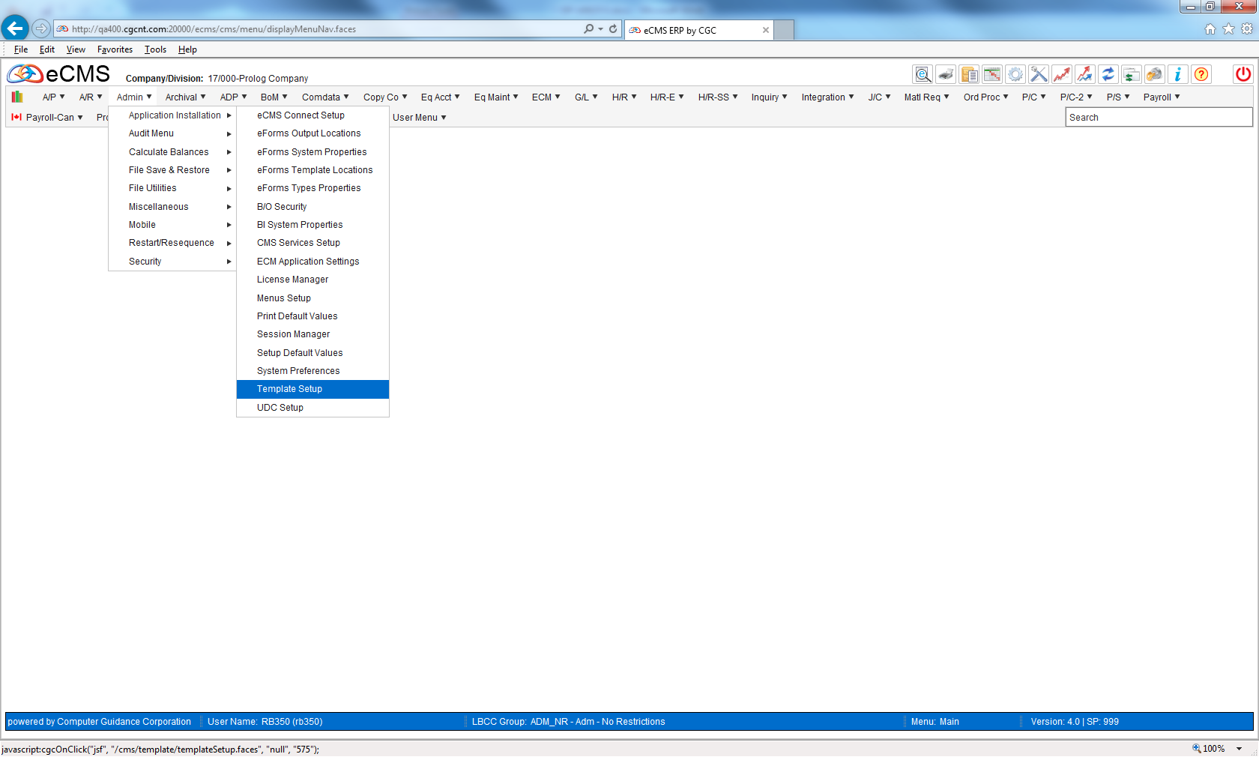
Accounts Payable Template
Admin > Application Installation > Template Setup

Slide 5
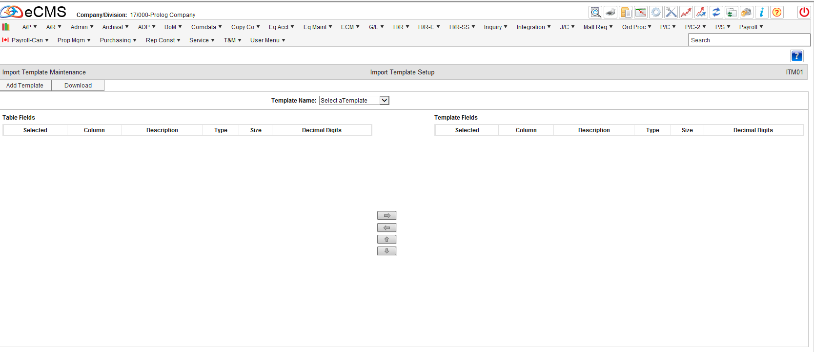
Accounts Payable Template
Add Template

Slide 6
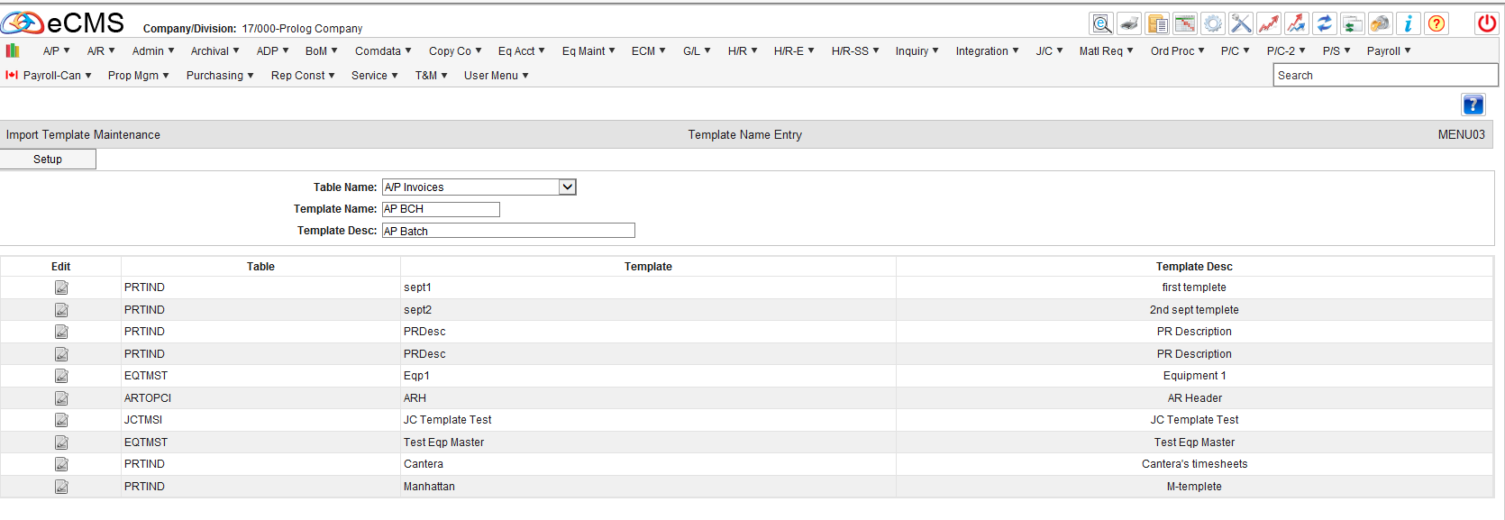
Accounts Payable Template
OK

Slide 7
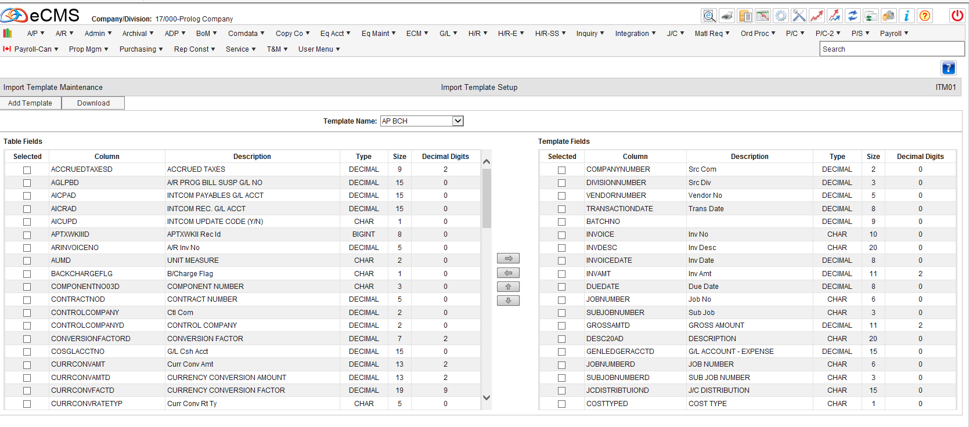
Accounts Payable Template
Select Template Fields by using the arrows Up/ Down or Left/Right in the Center

Slide 8
Accounts Payable Template
For My Selection I Selected the Following
Source Company
Source Division
Vendor Number
Transaction Date
Batch Number
Invoice Number
Invoice Description (Header)
Invoice Amount
Due Date
Job Number (Header)
Sub-Job Number (Header)
Gross Amount
Description (Detail)
G/L Account – Expense
Job Number (Detail)
Sub-Job Number (Detail)
JC Distribution
Cost Type

Slide 9

Accounts Payable Template
Download Excel Template Format

Slide 10
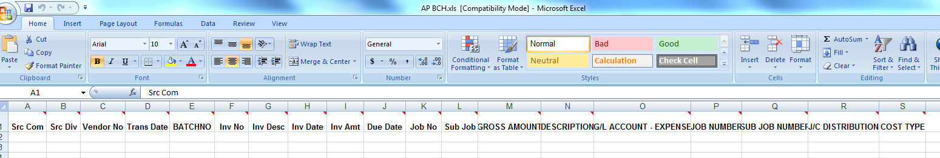
Accounts Payable Template
This will give you an excel spreadsheet with the Template fields populated in the order of your Import Template Setup

Slide 11
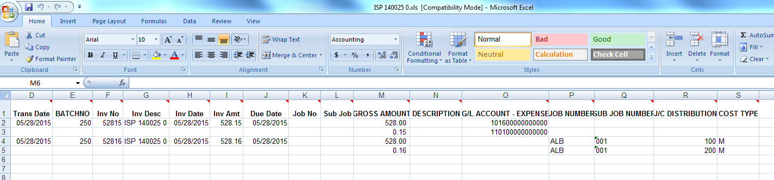
Accounts Payable Template
Populate the data on the Excel Spreadsheet and Save

Slide 12
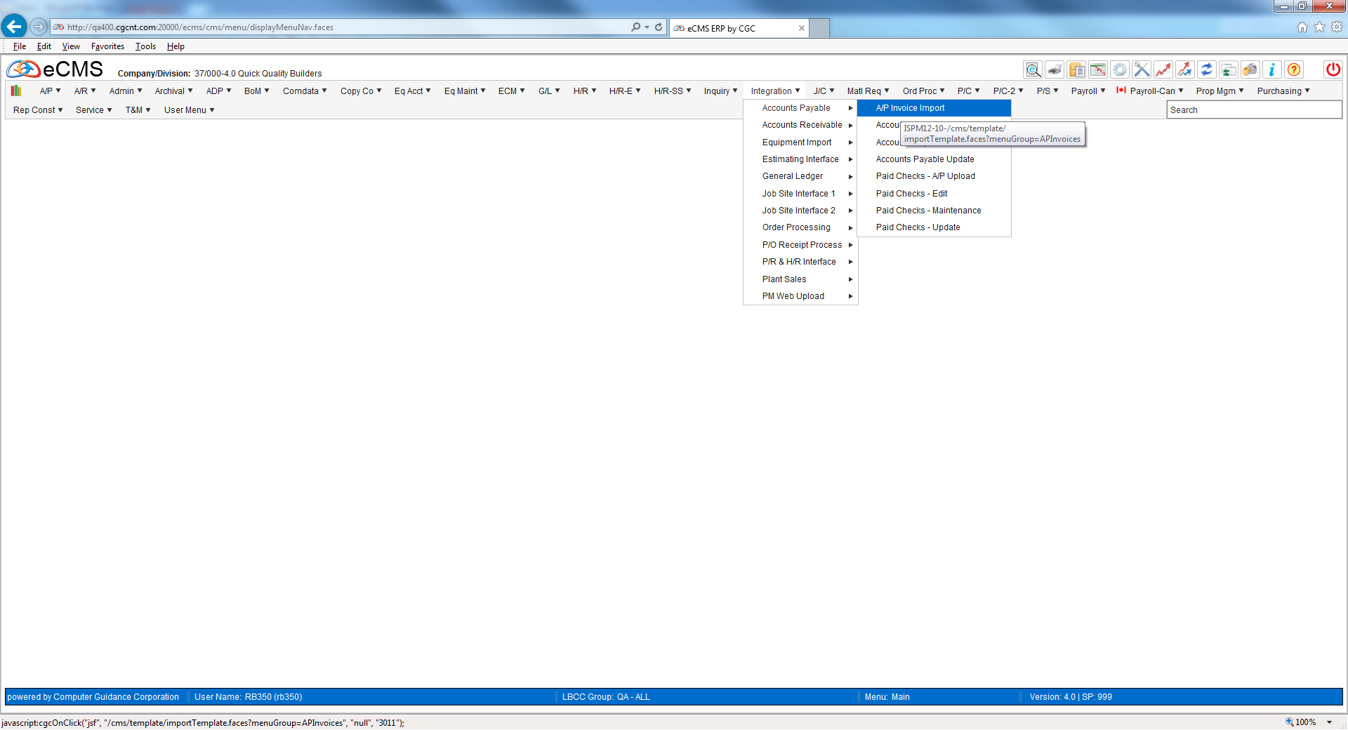
Accounts Payable Template
Integration > Accounts Payable > AP Invoice Import

Slide 13
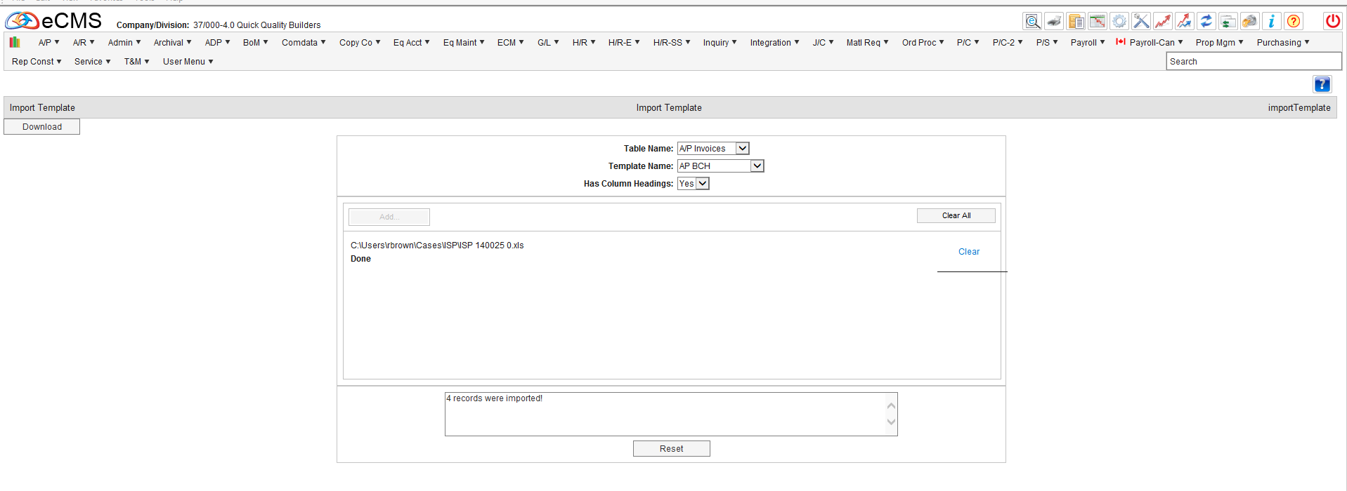
Accounts Payable Template
Select Table Name, Template Name and Has Columns Headings
Select Add and then Import

Slide 14
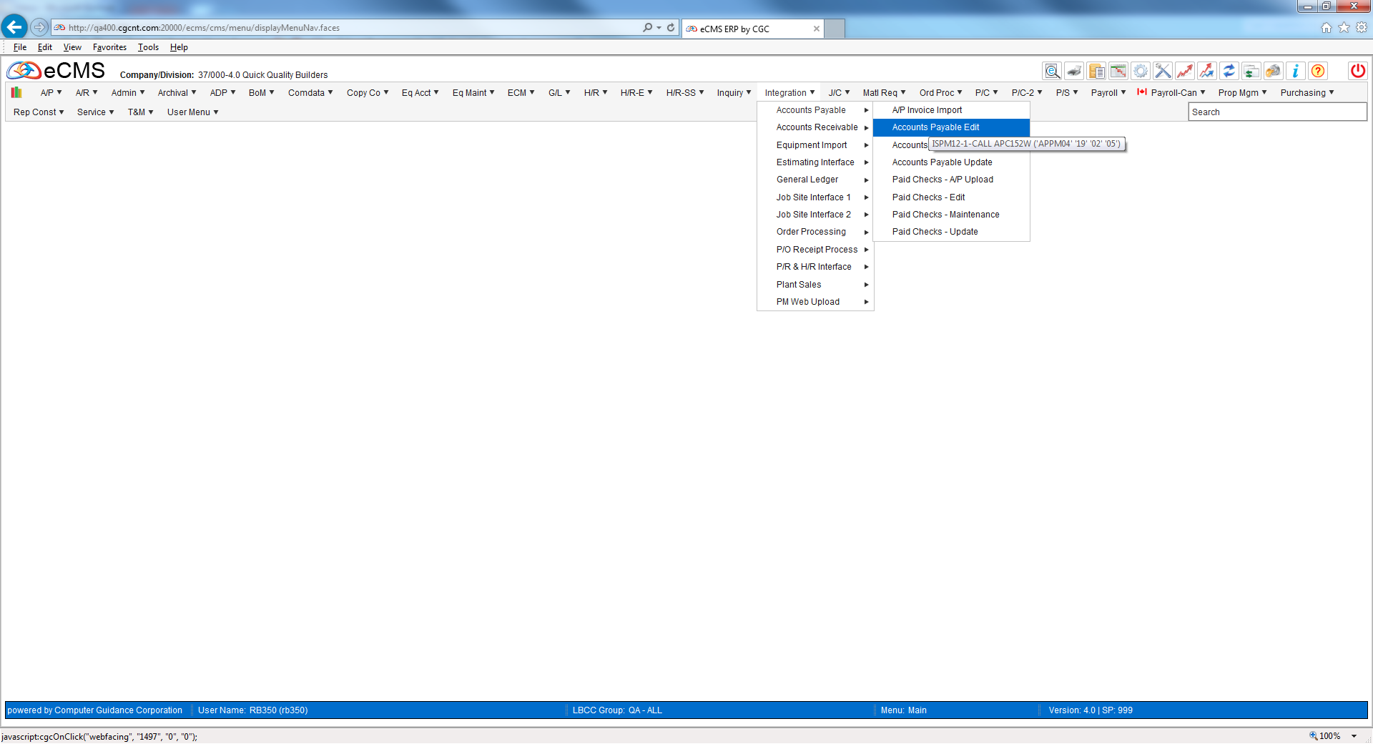
Accounts Payable Template
Integration > Accounts Payable > Accounts Payable Edit

Slide 15
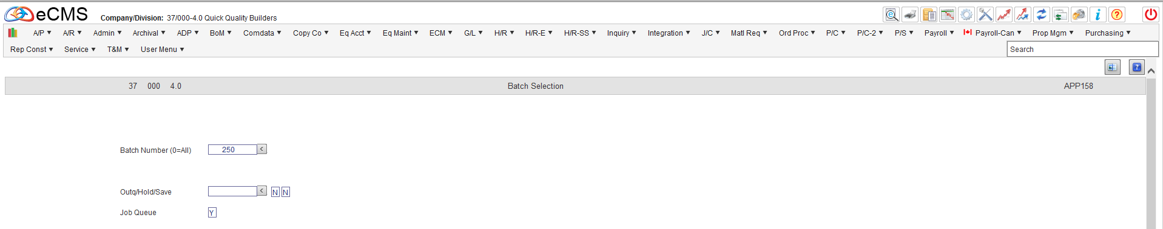
Accounts Payable Template
Select Batch and then OK

Slide 16
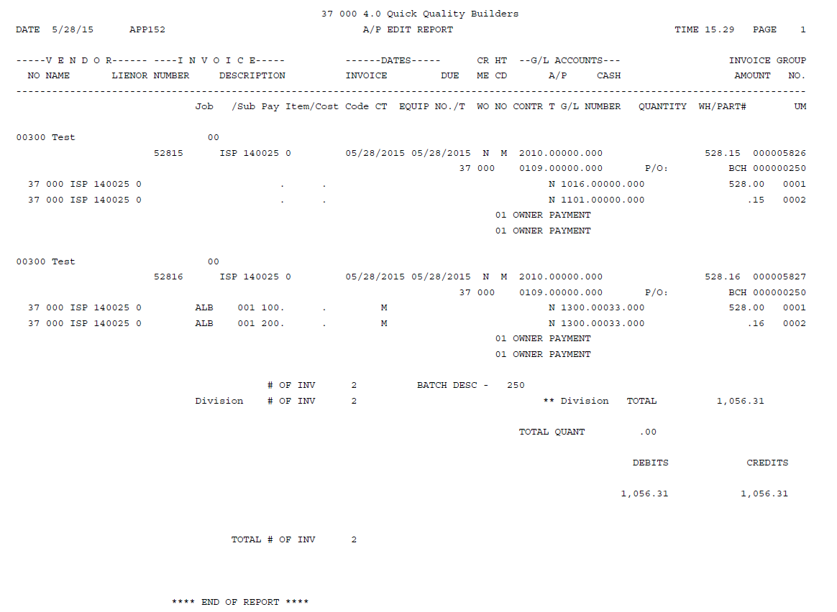
Accounts Payable Template
Verify the Edit Report Doesn’t have any Errors
If it does, go to Maintenance and correct errors.

Slide 17
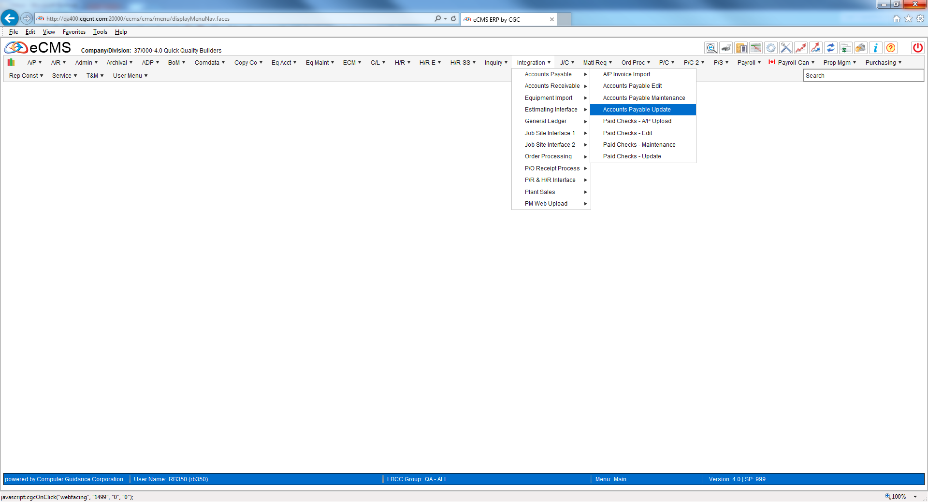
Accounts Payable Template
Integration > Accounts Payable > Accounts Payable Update

Slide 18
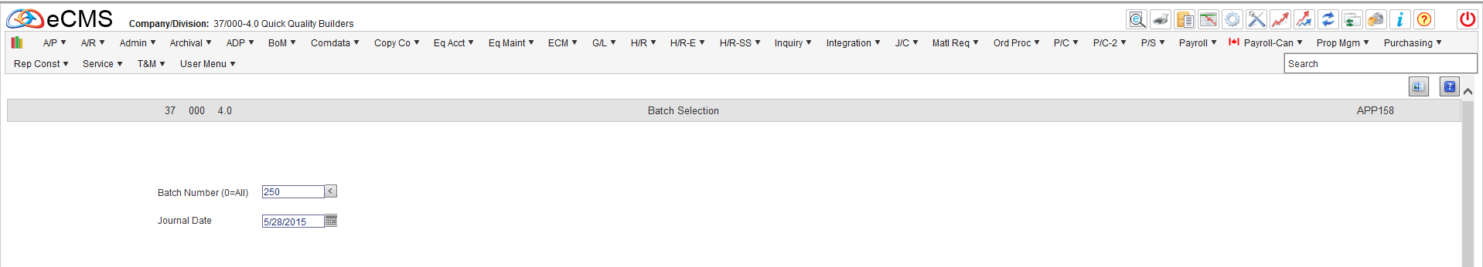
Accounts Payable Template
Select Batch Number and Journal Date

Slide 19
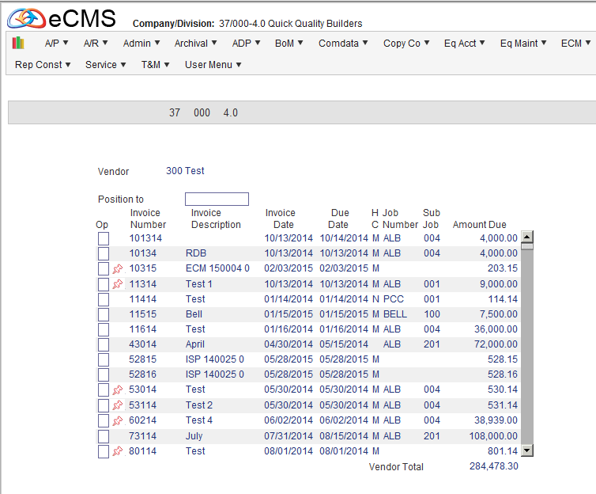
Accounts Payable Template
Invoices are Updated Directly to AP Through Integration

