Slide 1
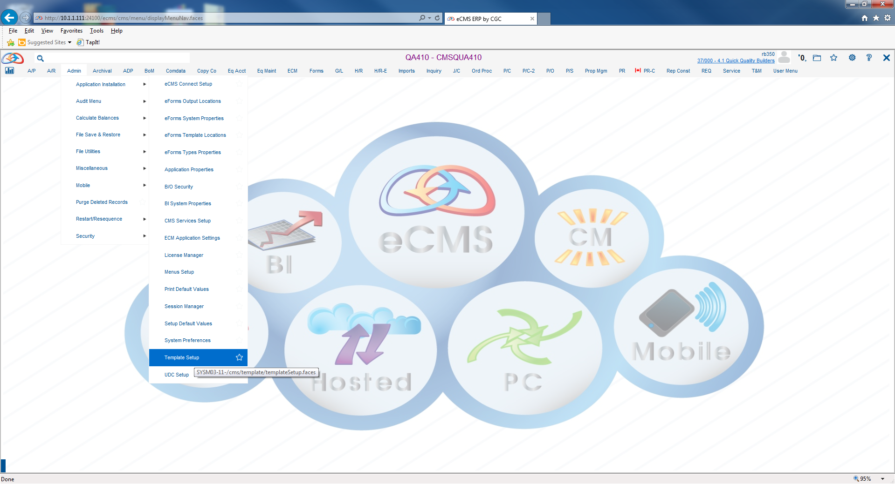
Equipment Rate Master Import
Admin > Application Installation > Template Setup

Slide 2
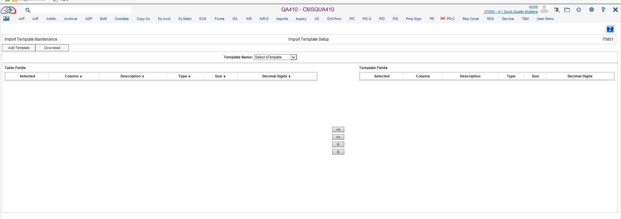
Equipment Rate Master Import
Admin > Application Installation > Template Setup
Add Template

Slide 3
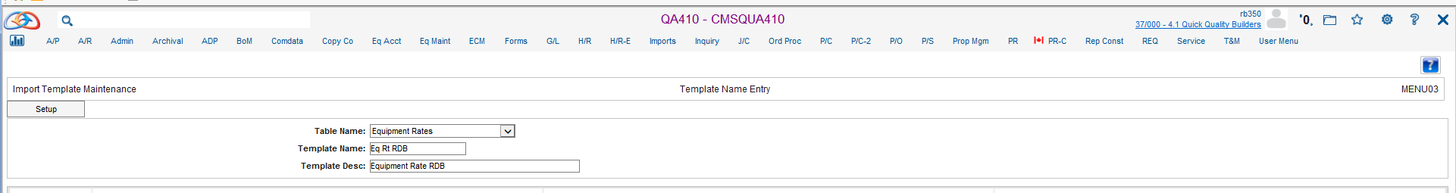
Equipment Rate Master Import
Admin > Application Installation > Template Setup

Slide 4
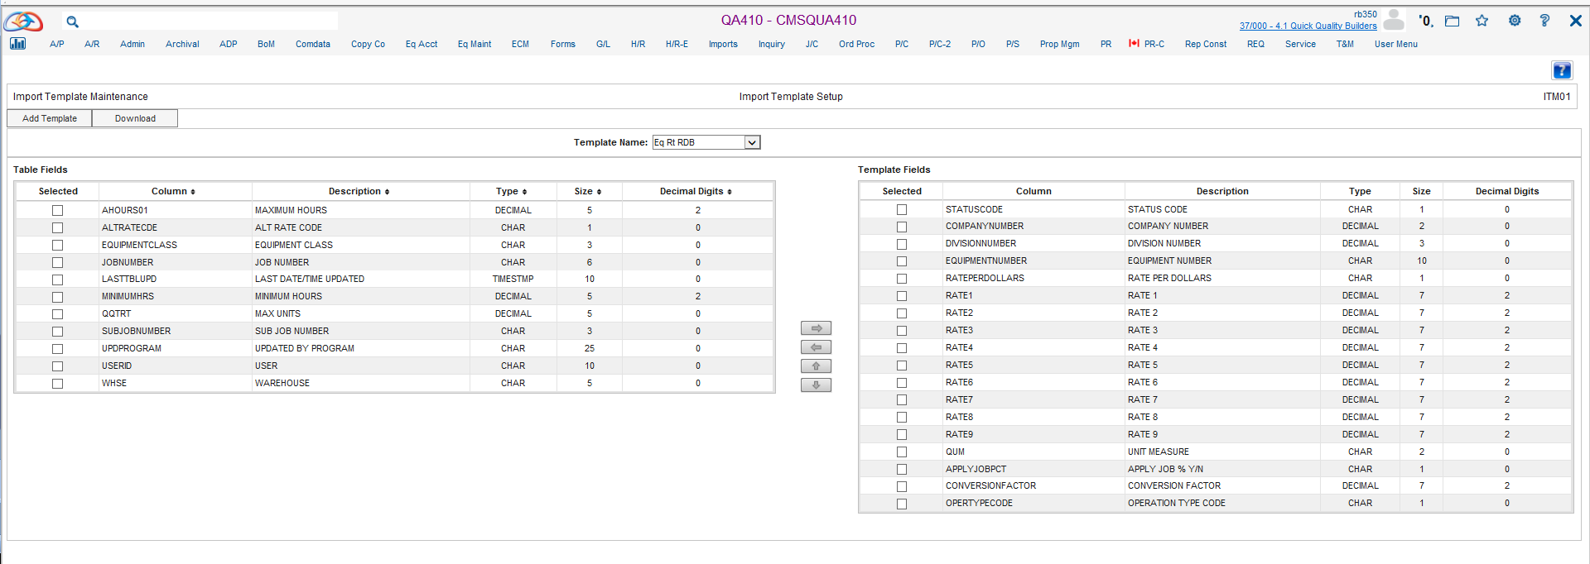
Equipment Rate Master Import
Admin > Application Installation > Template Setup
Setup Example

Slide 5
Equipment Rate Master Import
Admin > Application Installation > Template Setup
Setup Example
Template Fields
  Status Code (A)
  Company Number
  Division Number
  Equipment Number
  Rate 1
  Rate 2
  Rate 3
  Rate 4
  Rate 5
  Rate 6
  Rate 7
  Rate 8
  Rate 9
  Unit Measure
  Apply Job % Y/N
  Conversion Factor (Must be Entered)
  Operation Type Code(O=1, D=2, I=3)

Slide 6
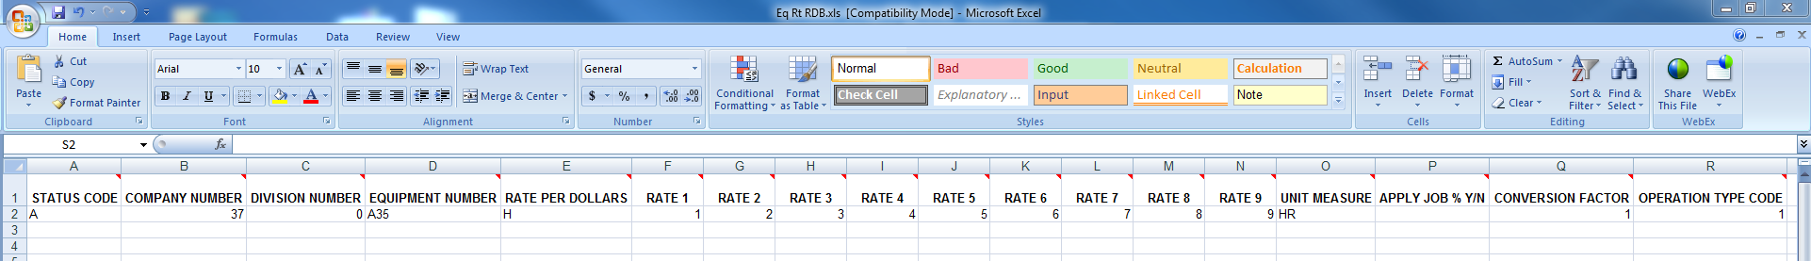
Equipment Rate Master Import
Admin > Application Installation > Template Setup
Download Template and Populate

Slide 7
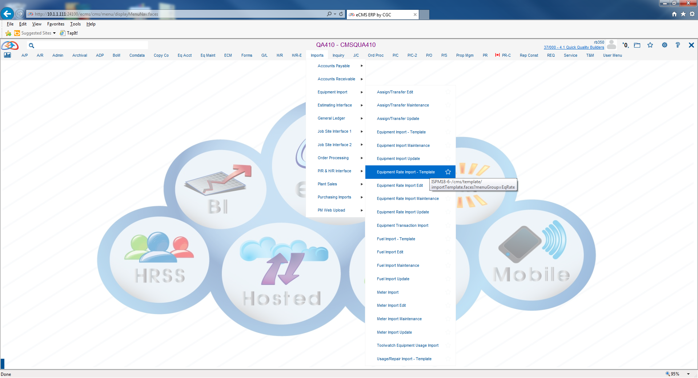
Equipment Rate Master Import
Import > Equipment Import > Equipment Rate Import – Template

Slide 8
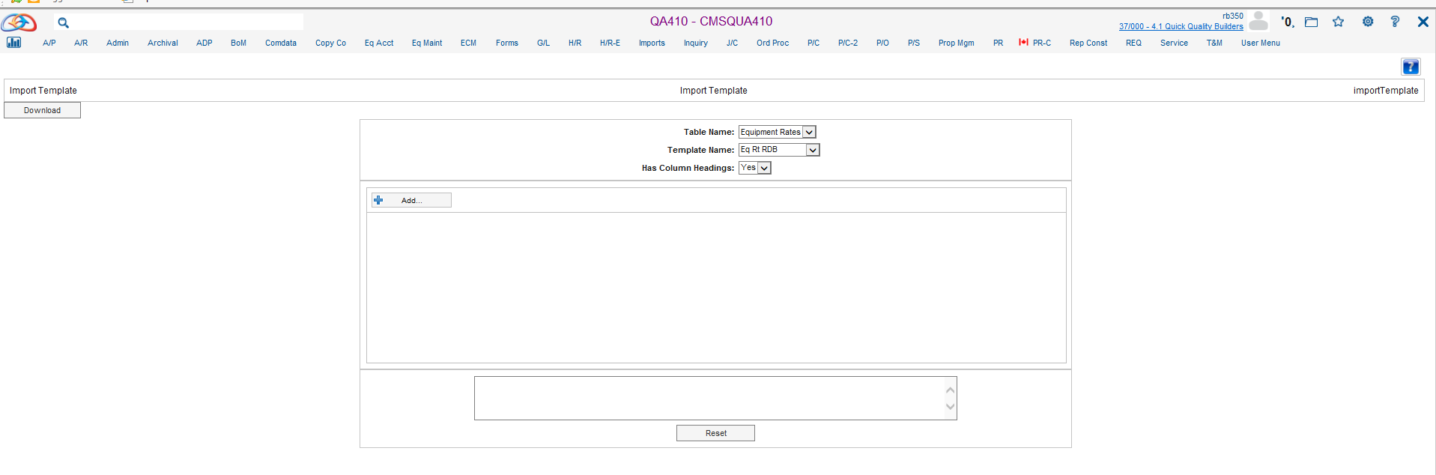
Equipment Rate Master Import
Import > Equipment Import > Equipment Rate Import – Template
Select Table Name, Template Name and Has Column Headings.
Add File

Slide 9
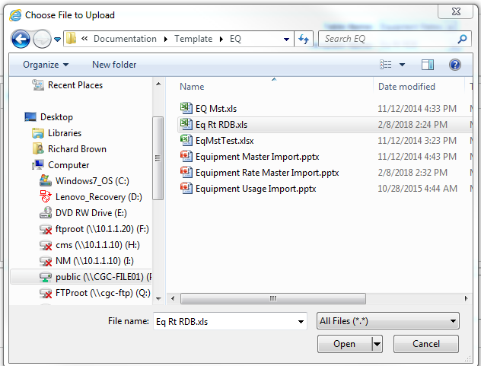
Equipment Rate Master Import
Import > Equipment Import > Equipment Rate Import – Template

Slide 10
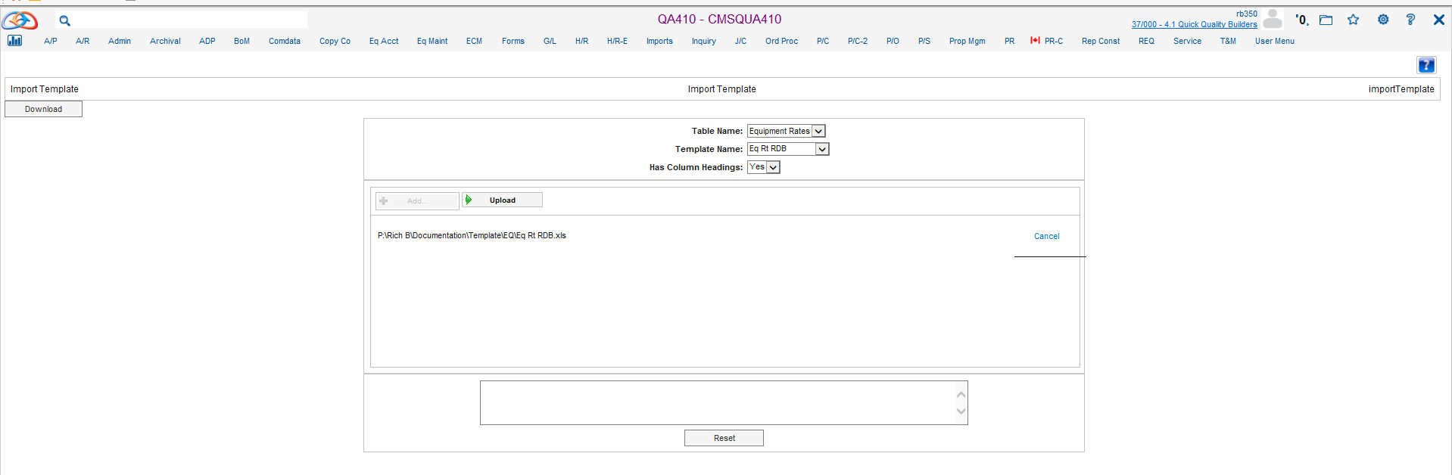
Equipment Rate Master Import
Import > Equipment Import > Equipment Rate Import – Template
Upload

Slide 11
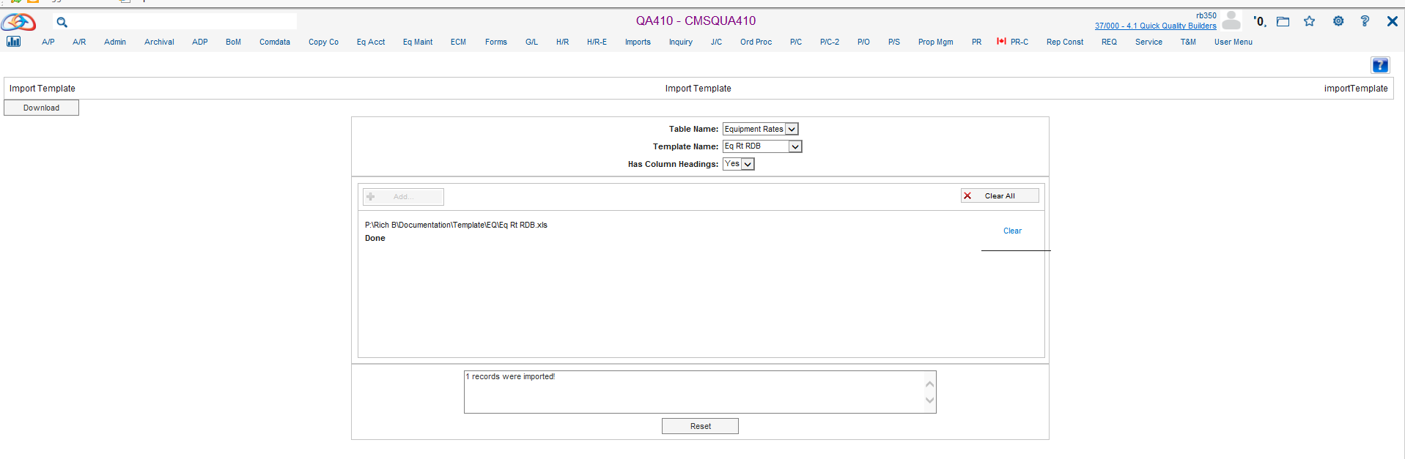
Equipment Rate Master Import
Import > Equipment Import > Equipment Rate Import – Template

Slide 12
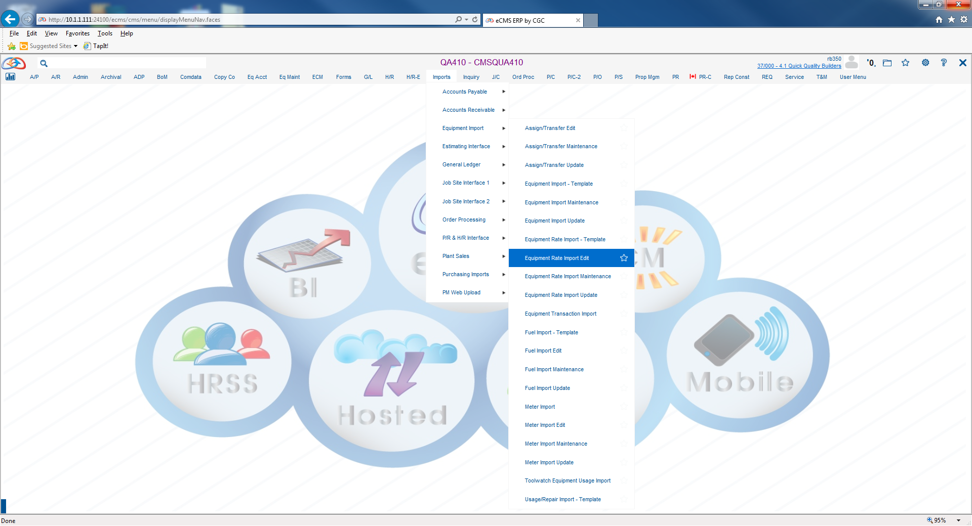
Equipment Rate Master Import
Import > Equipment Import > Equipment Rate Import Edit

Slide 13
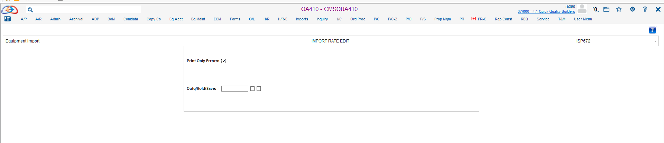
Equipment Rate Master Import
Import > Equipment Import > Equipment Rate Import Edit

Slide 14
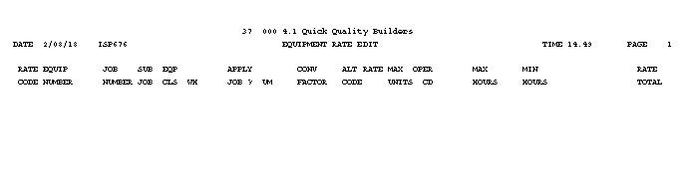
Equipment Rate Master Import
Import > Equipment Import > Equipment Rate Import Edit
This Report will have Results for Errors Only

Slide 15
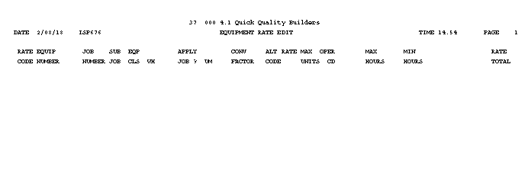
Equipment Rate Master Import
Import > Equipment Import > Equipment Rate Import Edit
If the Transaction is Correct The Report will be Empty

Slide 16
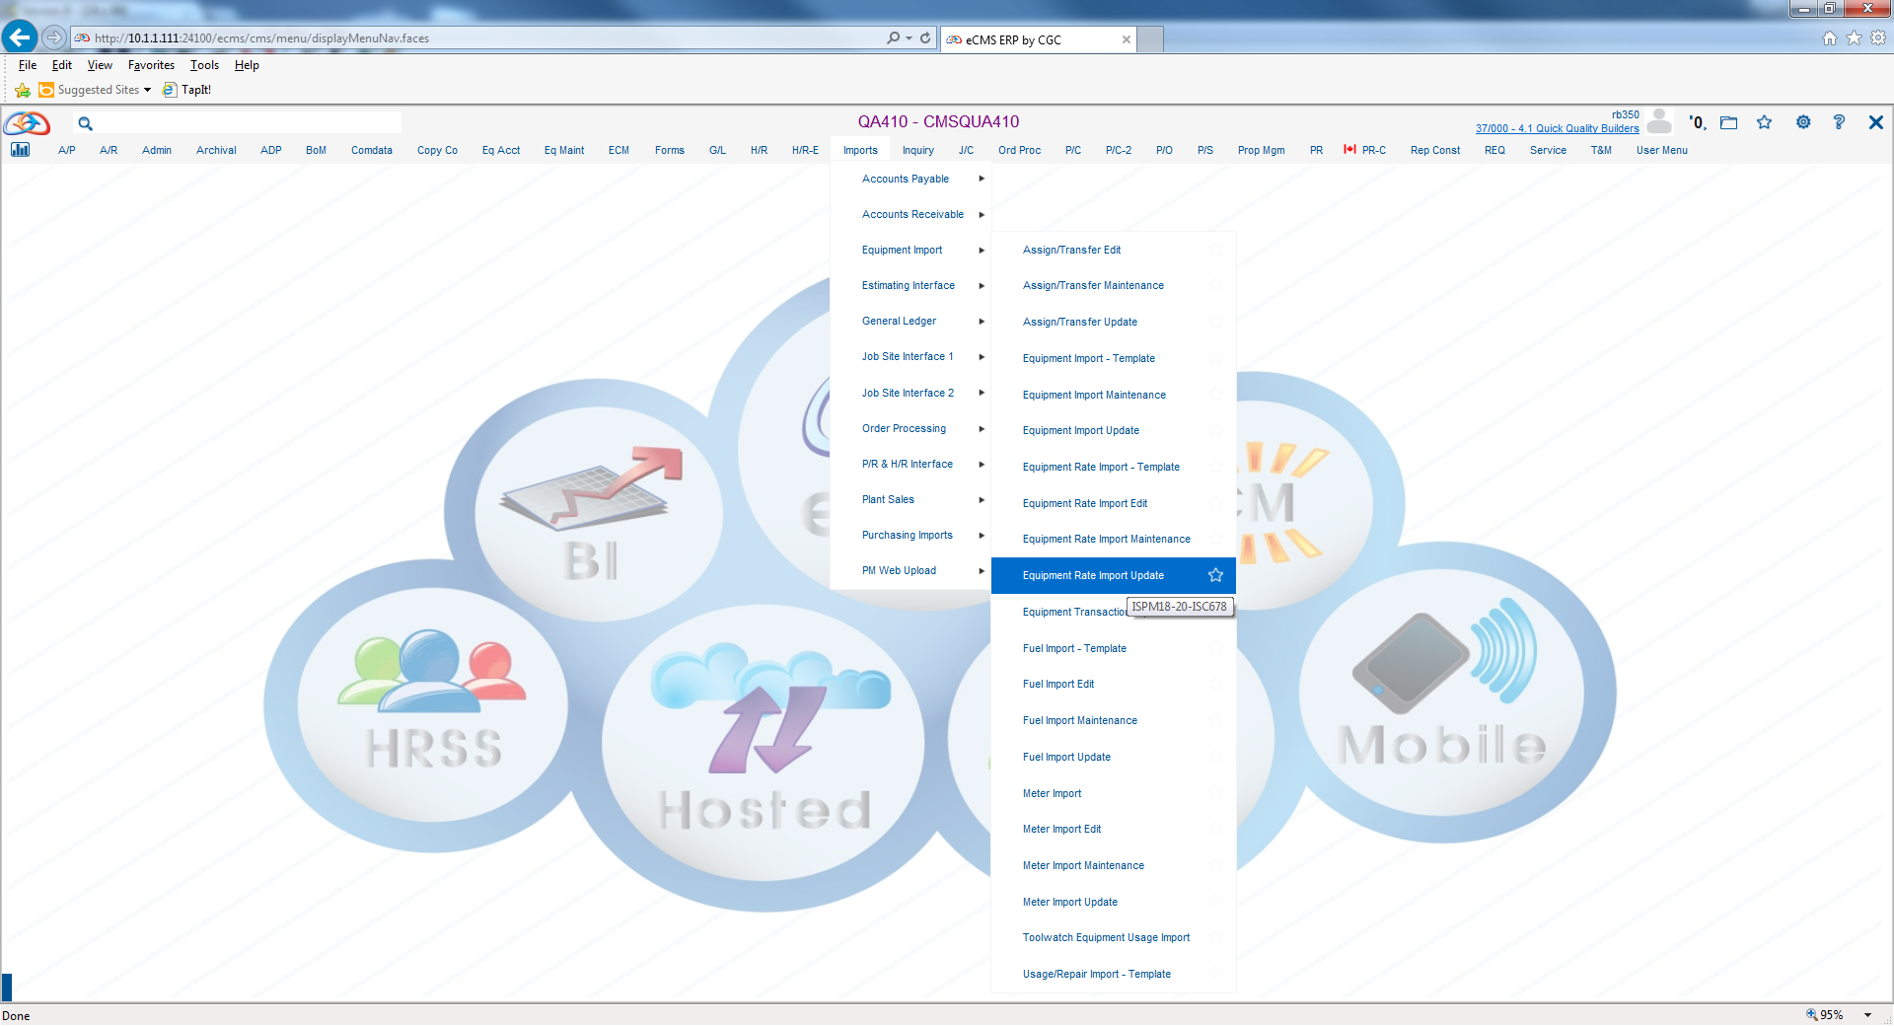
Equipment Rate Master Import
Import > Equipment Import > Equipment Rate Import Update

Slide 17
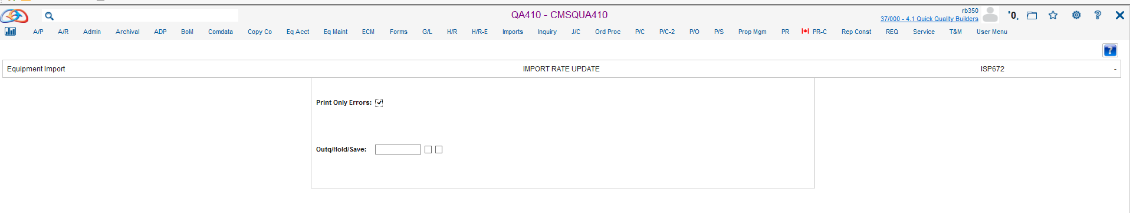
Equipment Rate Master Import
Import > Equipment Import > Equipment Rate Import Update

Slide 18
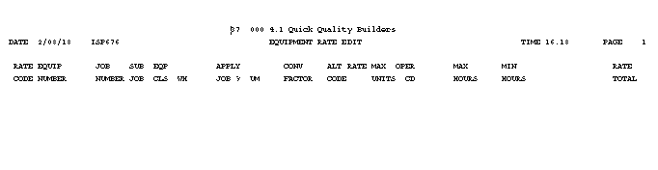
Equipment Rate Master Import
Import > Equipment Import > Equipment Rate Import Update

Slide 19
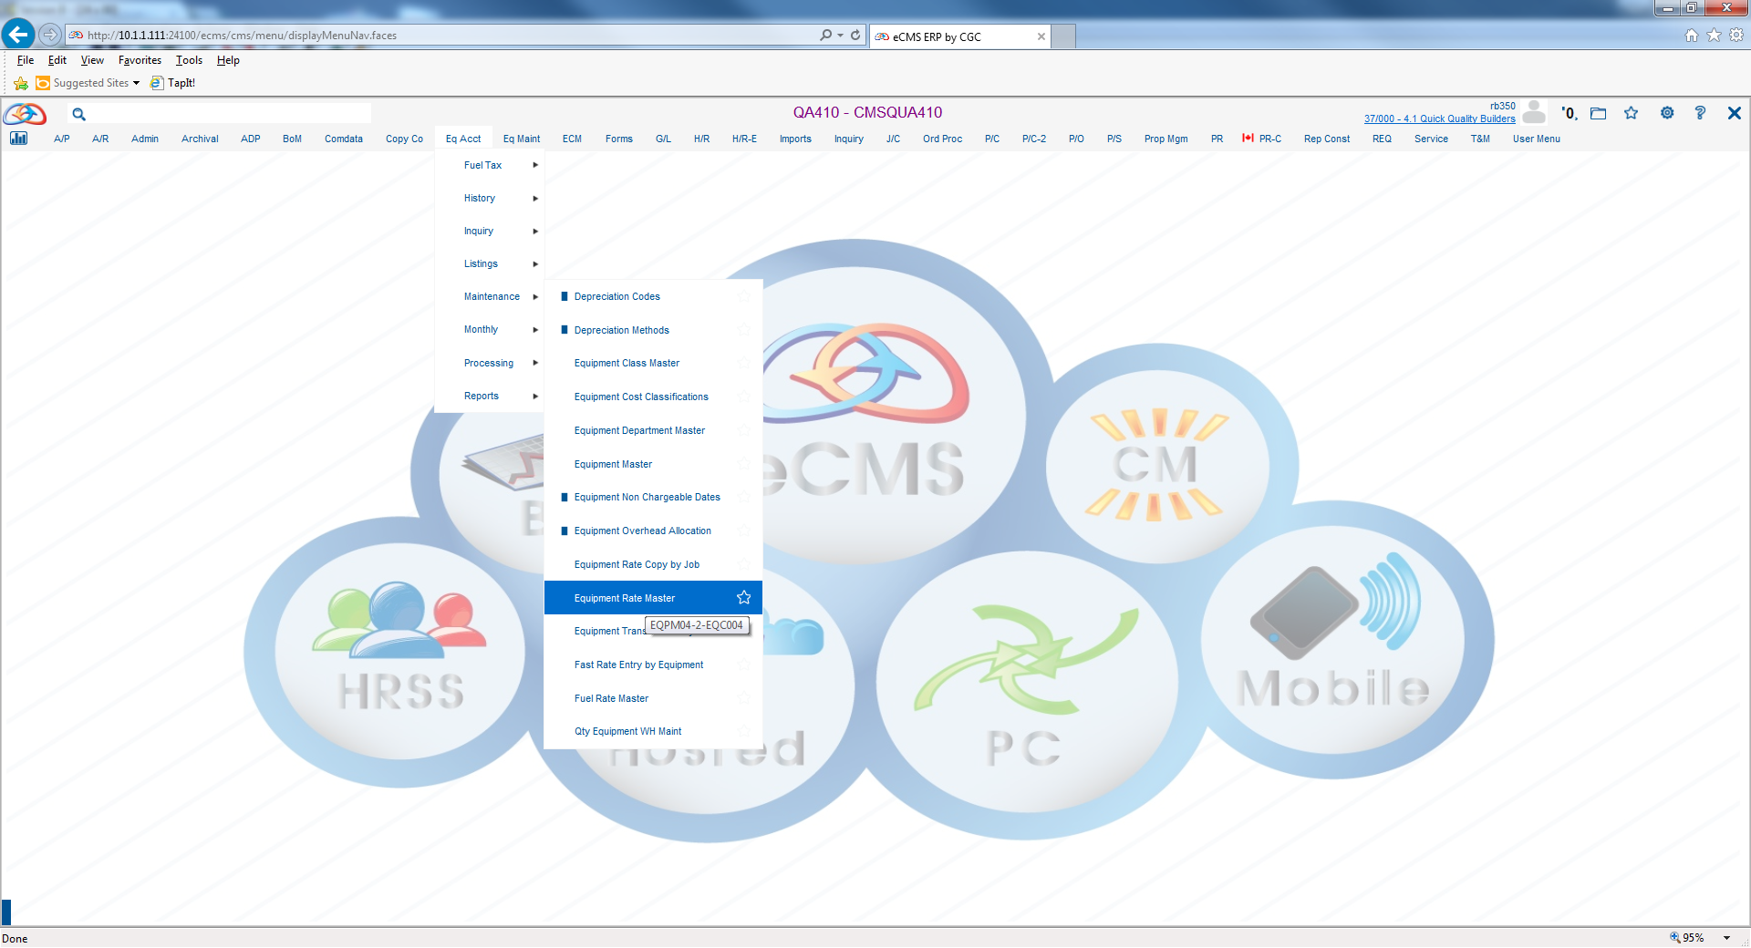
Equipment Rate Master Import
Eq Acct > Maintenance > Equipment Rate Master

Slide 20
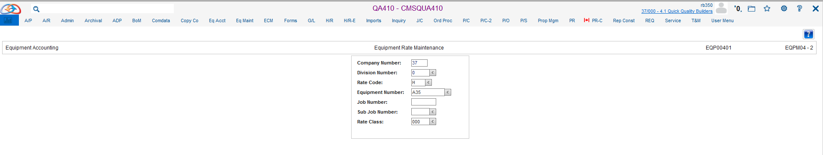
Equipment Rate Master Import
Eq Acct > Maintenance > Equipment Rate Master

Slide 21
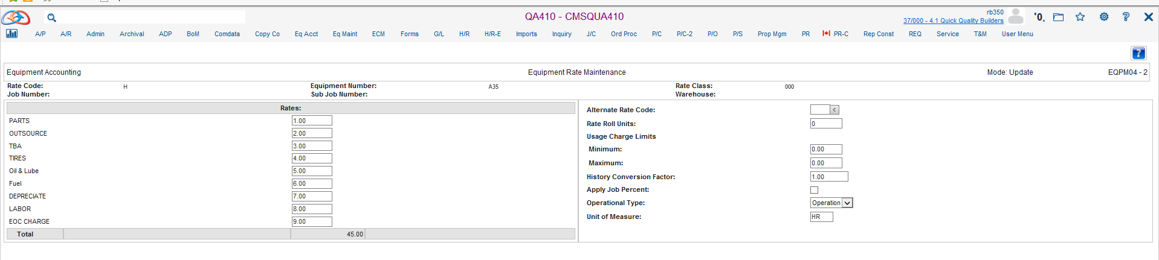
Equipment Rate Master Import
Eq Acct > Maintenance > Equipment Rate Master

