Slide 1
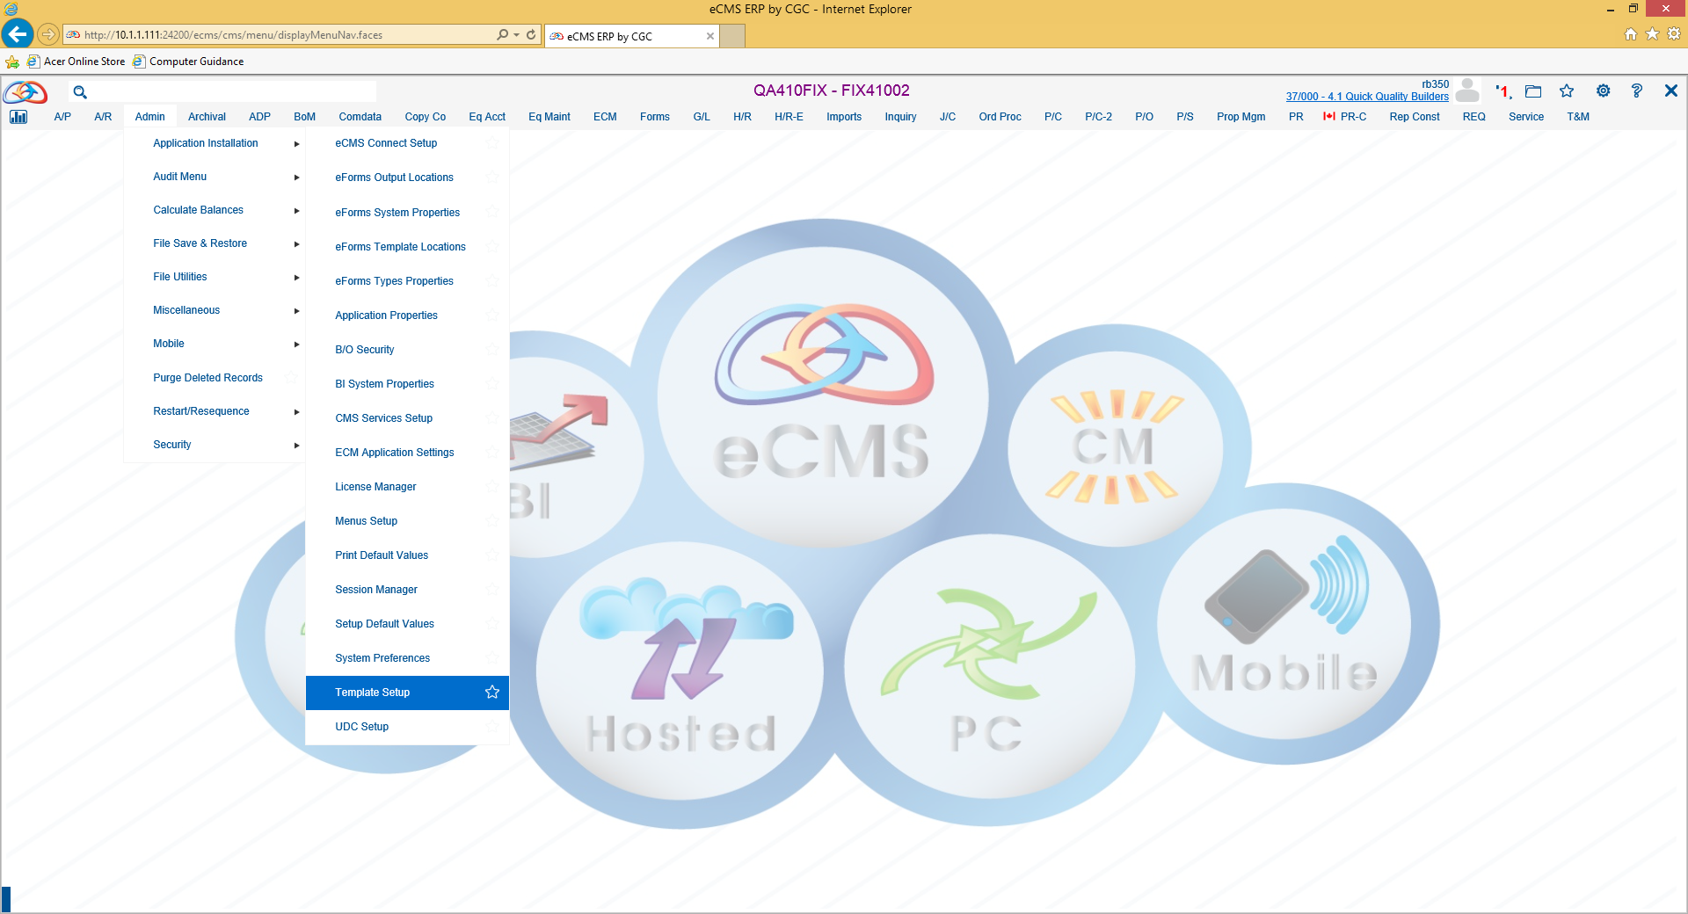
Payroll Equipment Repair Import
Admin > Application Installation > Template Setup

Slide 2
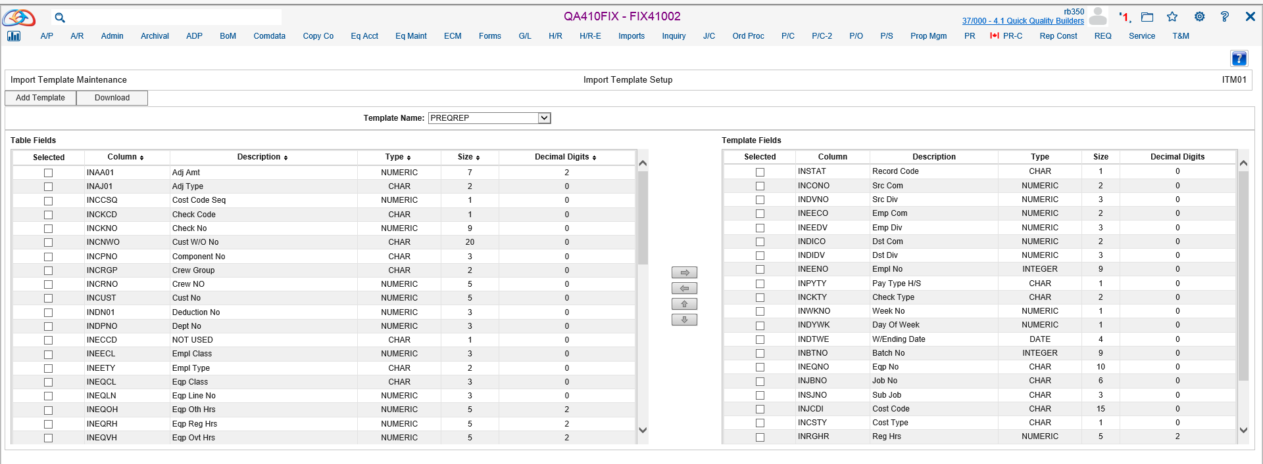
Payroll Timecard Template Setup
Select “Add Template”

Slide 3
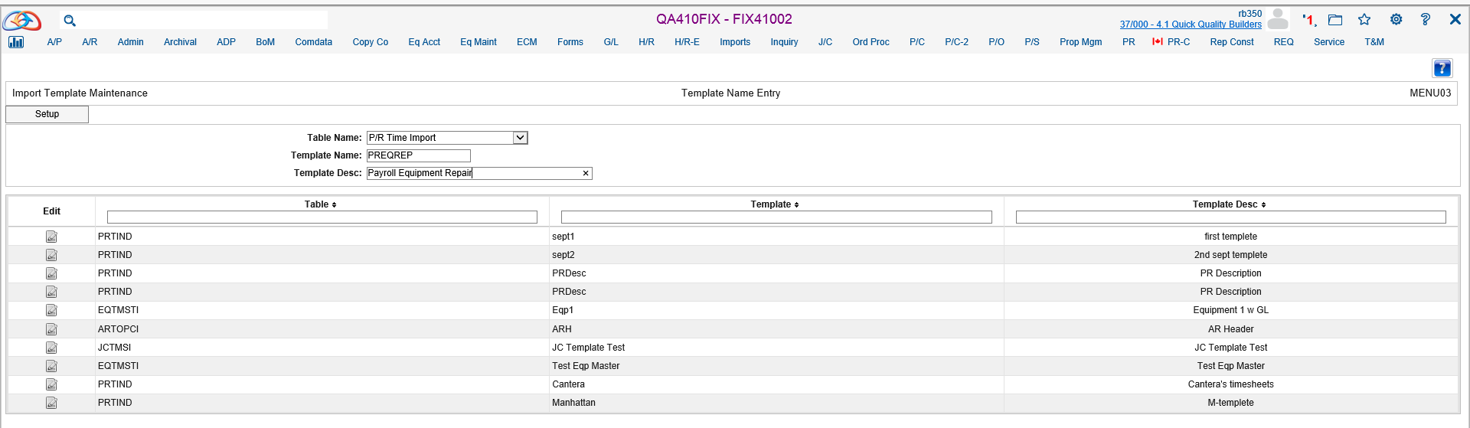
Payroll Timecard Template Setup
Select Template Name and Enter Template Name and Description

Slide 4
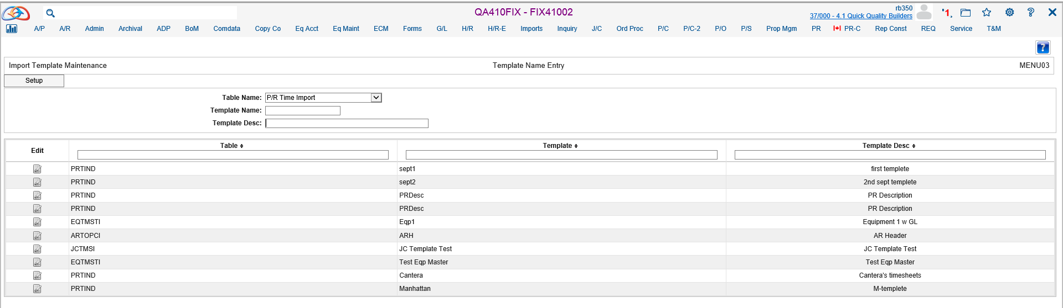
Payroll Timecard Template Setup
Select “Setup”

Slide 5
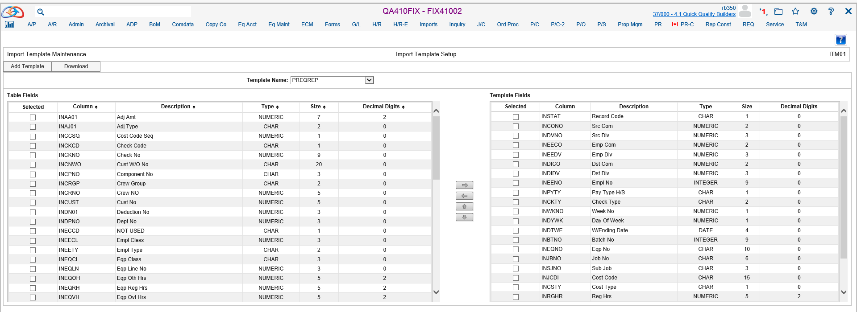
Payroll Timecard Template Setup
Select Template Name
Select the Required and Supplemental Templates Fields by Using the Arrows

Slide 6
Payroll Timecard Template Setup
Select Template Name
Select the Required and Supplemental Templates Fields by Using the Arrows

Slide 7
Payroll Timecard Template Setup
Required Template Fields
Record Code (A = Active)
Src Com
Src Div
Emp Com
Emp Div
Dst Com
Dst Div
Emp No
Pay Type H/S (H = Hourly / S = Salary)
Check Type
Week No
Day of Week
W/Ending Date
Batch No
Eqp No
Job No
Sub Job
Cost Code
Cost Type
Reg Hrs
Oth Hrs
Oth Hrs Type
Eqp Code E-Eqp
Eqp Cost Type

Slide 8
Excel Payroll Timecard Template Setup
Select Download to Receive an Excel Template

Slide 9
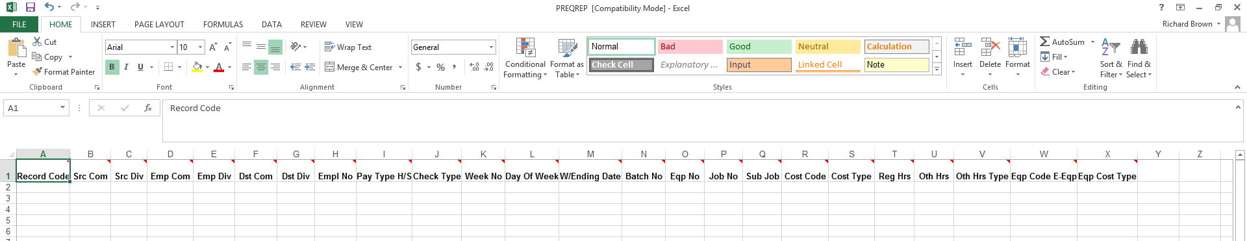
Excel Payroll Timecard Template Setup eCMS Will Produce an Excel Spreadsheet With the Columns Selected.

Slide 10
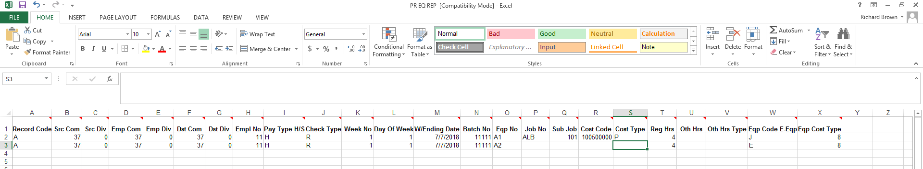
Excel Payroll Timecard Template Setup
Enter Data Into Excel Spreadsheet and Save

Slide 11
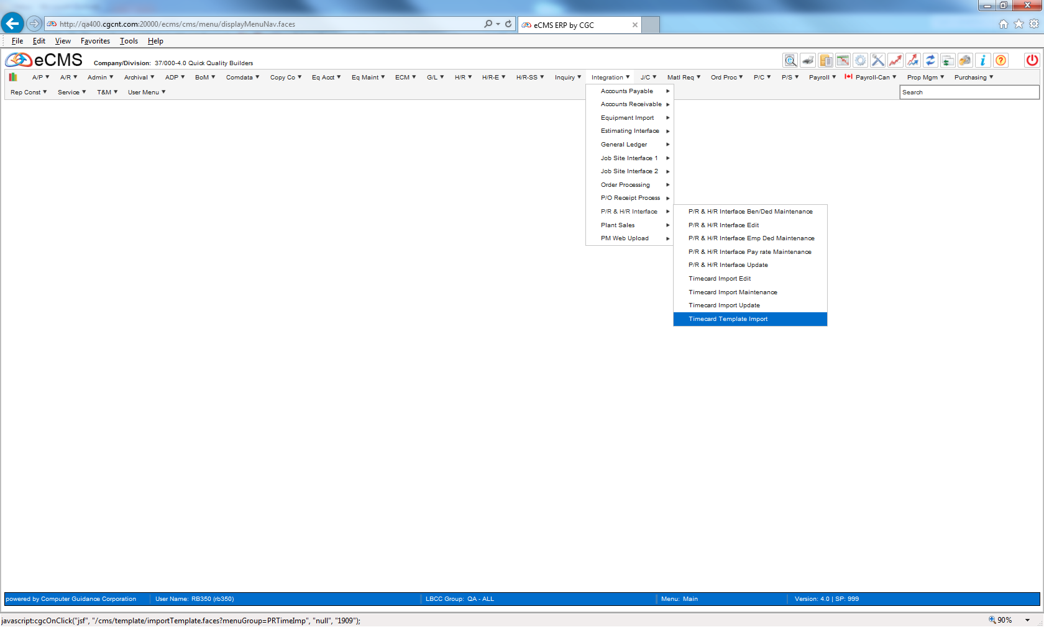
Payroll Timecard Template Import
Integration | PR & HR Interface| Timecard Template Import

Slide 12
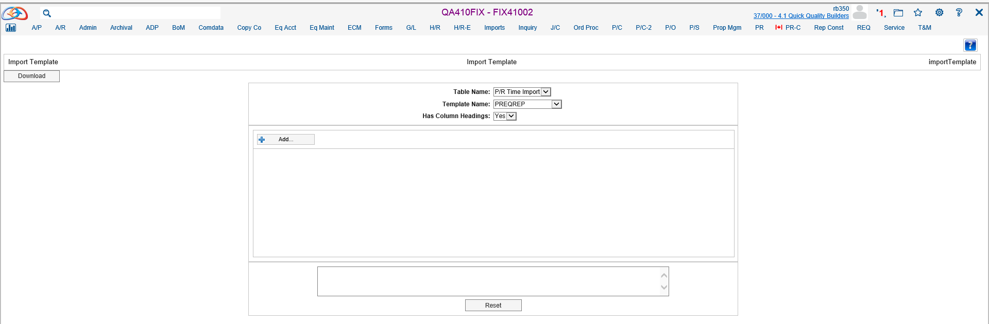
Payroll Timecard Template Import
Select “Table Name”, “Template Name” and “Has Column Headings” From the Dropdowns
Select “Add”

Slide 13
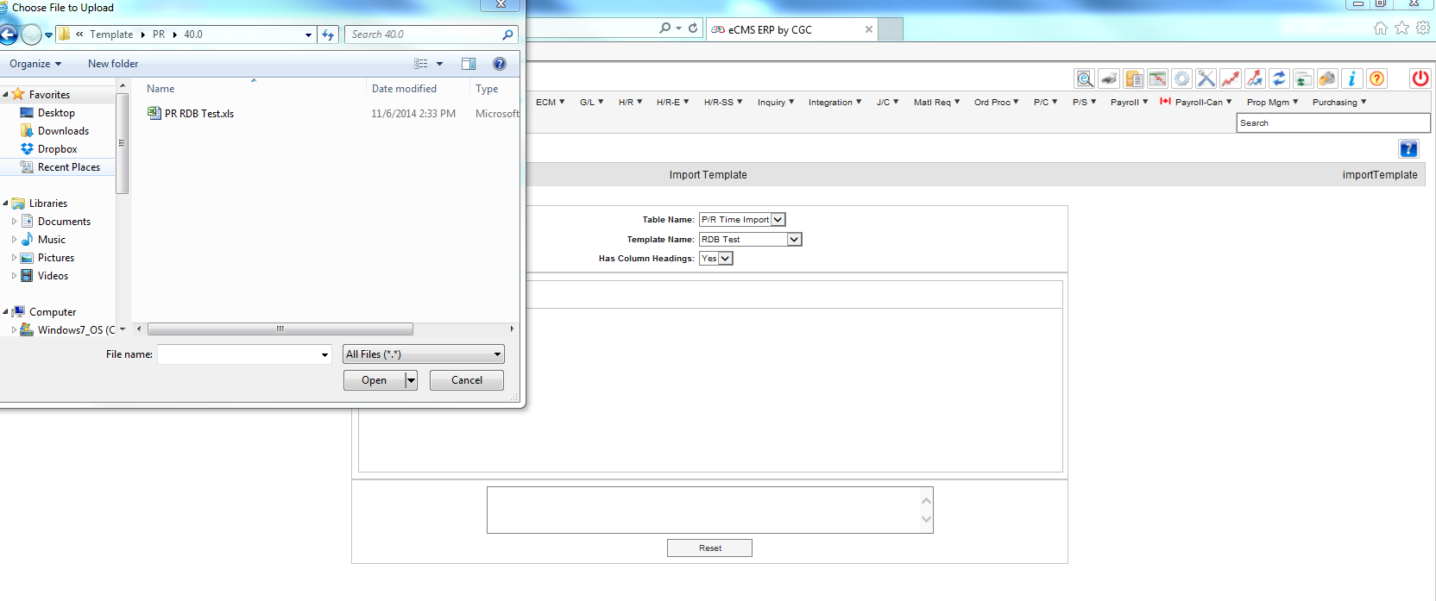
Payroll Timecard Template Import
Select File to Upload

Slide 14
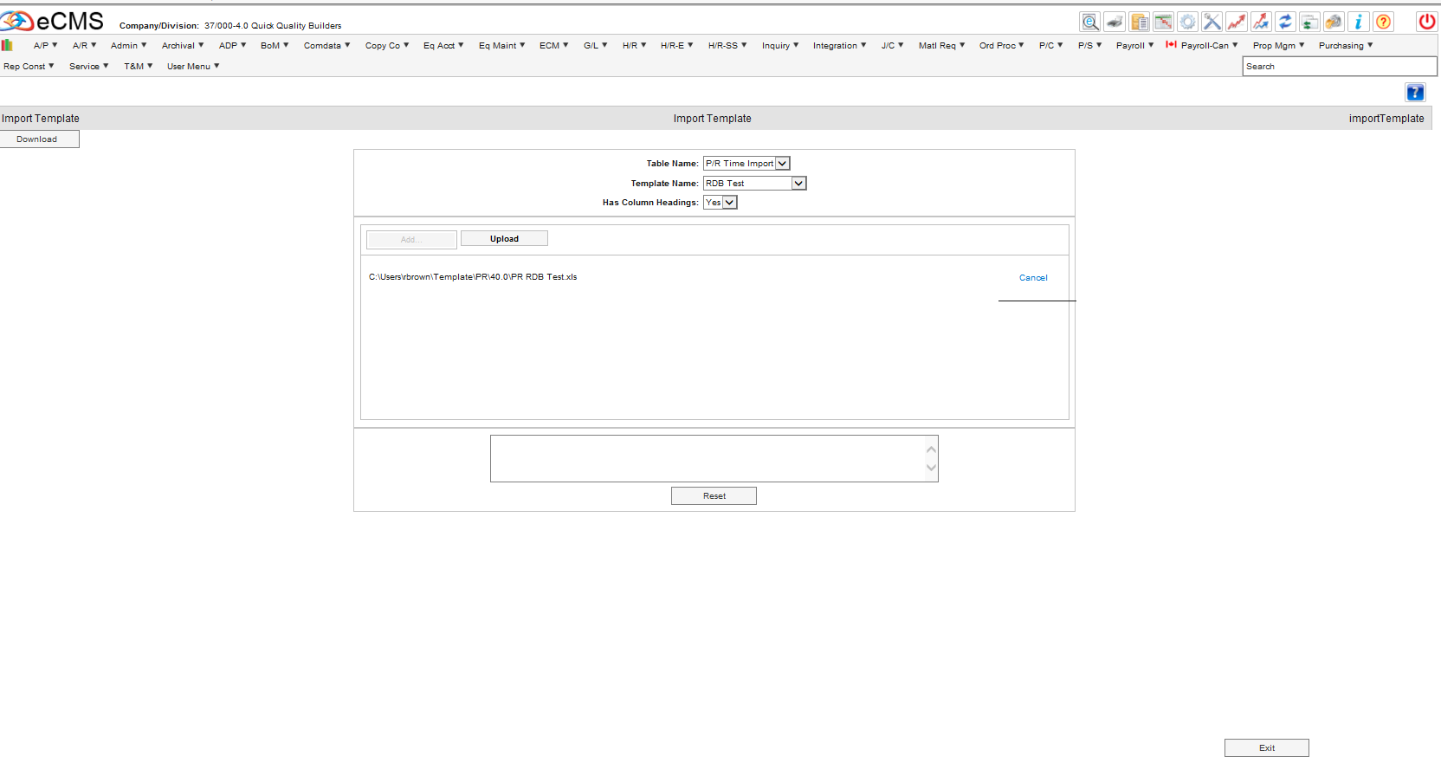
Payroll Timecard Template Import
Select Upload

Slide 15
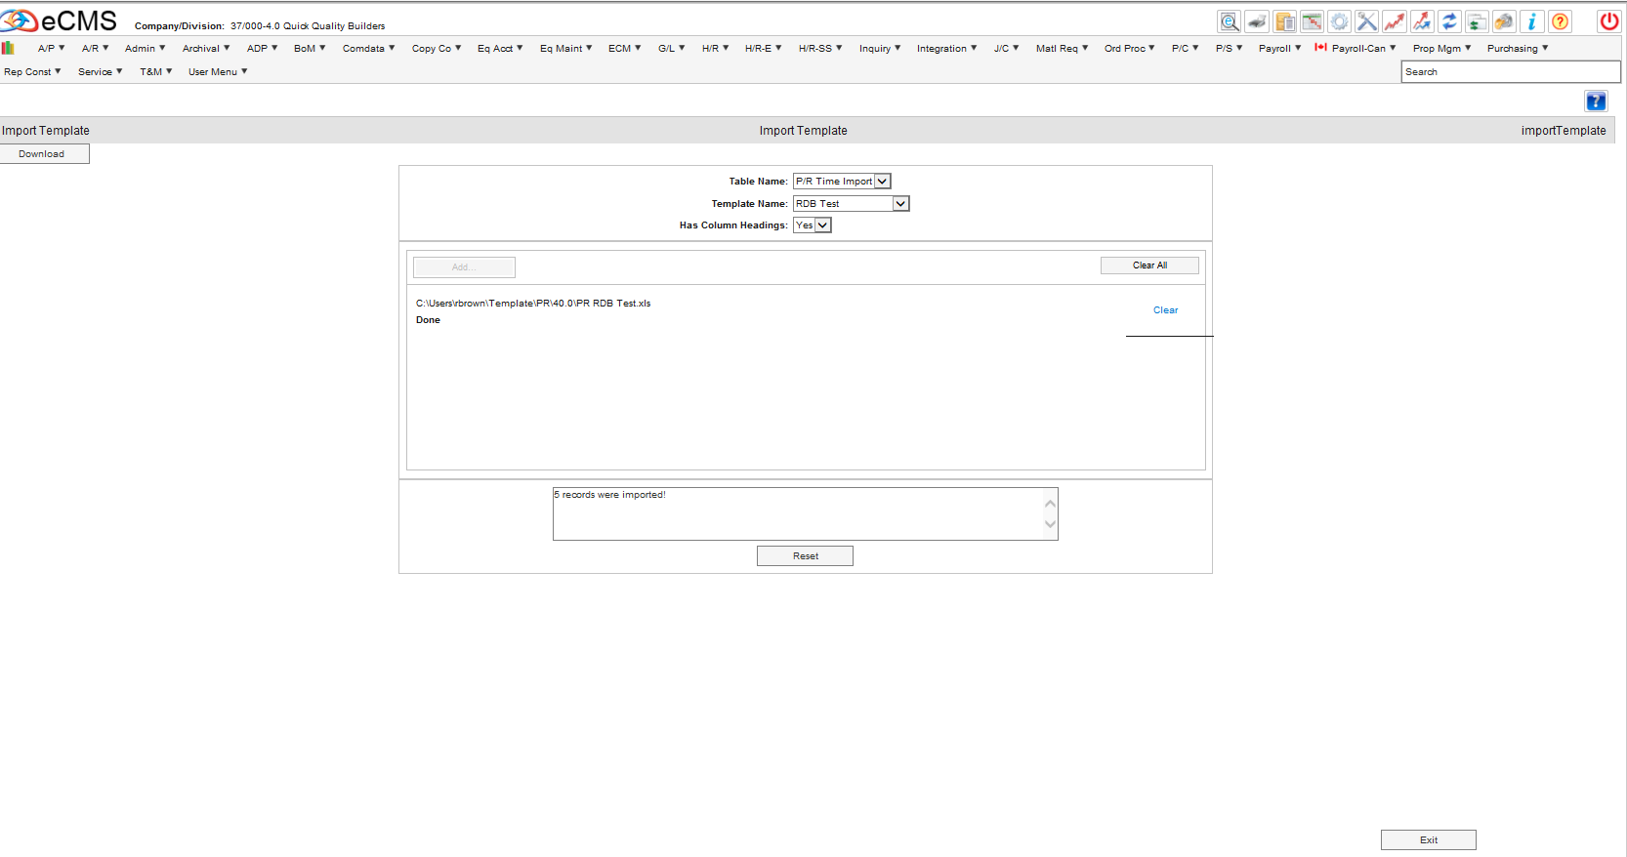
Payroll Timecard Template Import
Proceed After Successful Upload Message

Slide 16
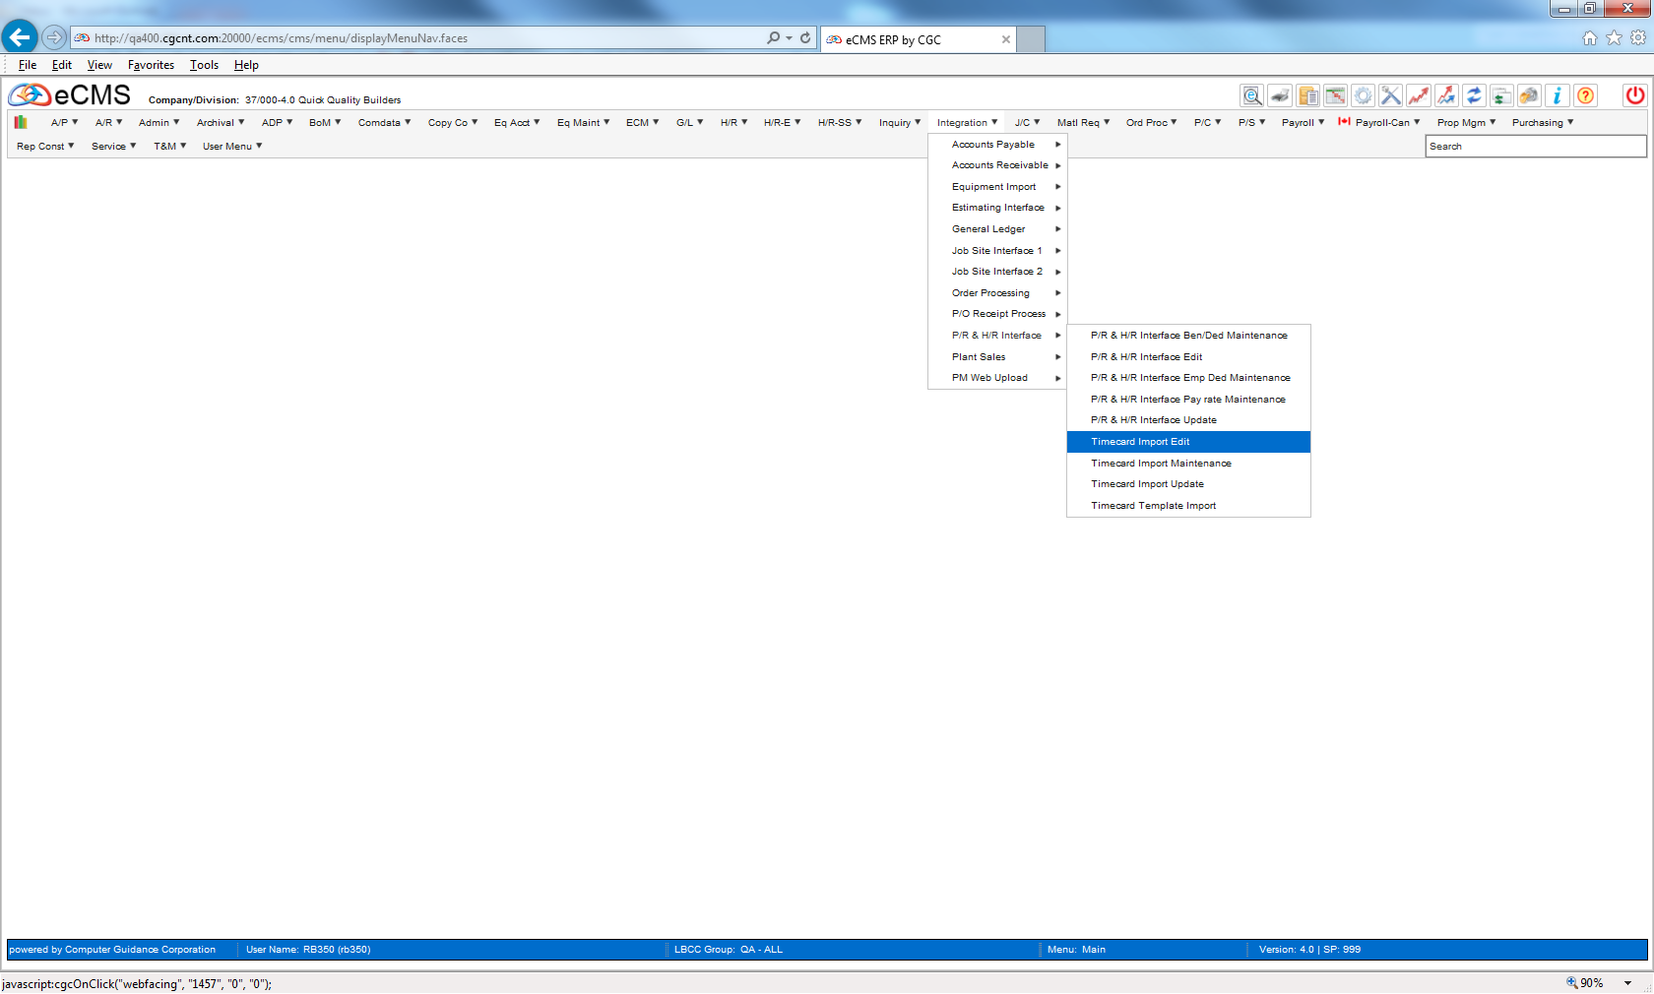
Payroll Timecard Template Import
Integration| PR & HR Interface| Timecard Import Edit

Slide 17
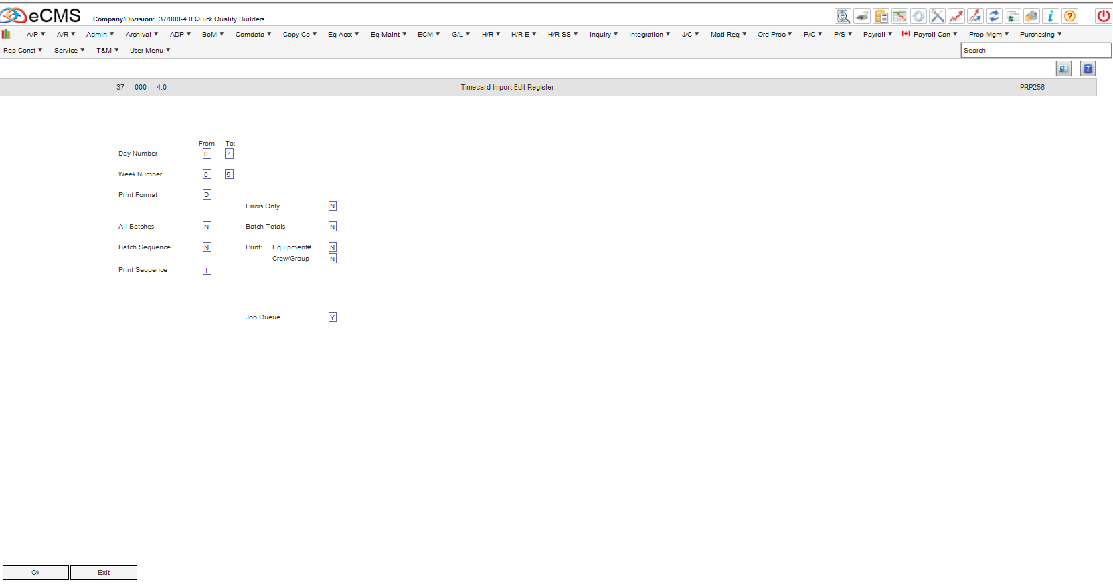
Payroll Timecard Template Import
Select Criteria

Slide 18
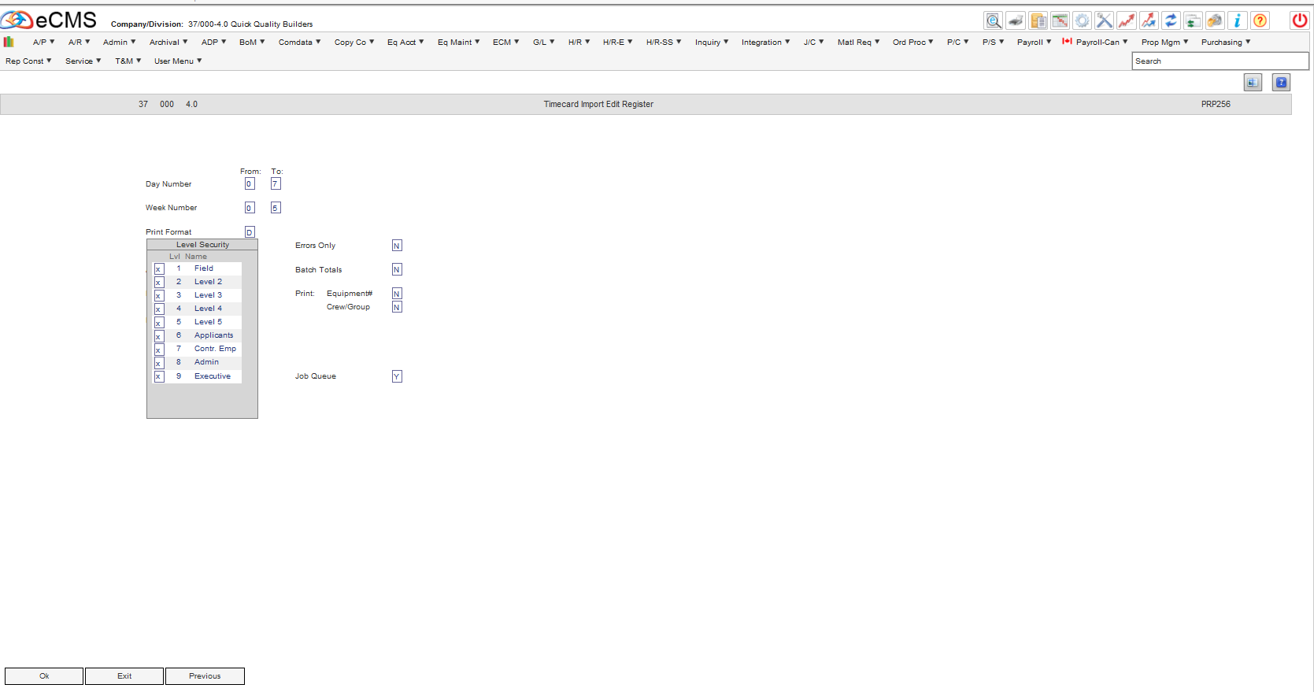
Payroll Timecard Template Import
Select the Level(s) of Security

Slide 19
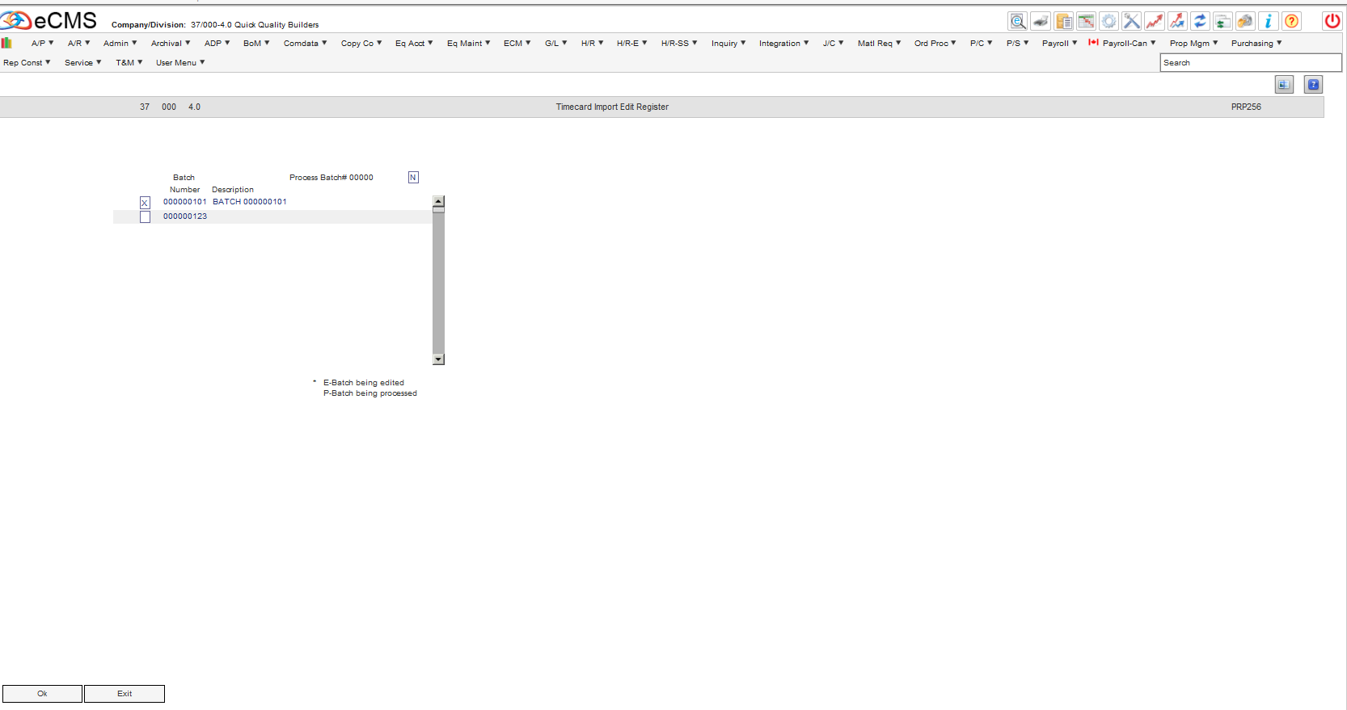
Payroll Timecard Template Import
Select Batch

Slide 20
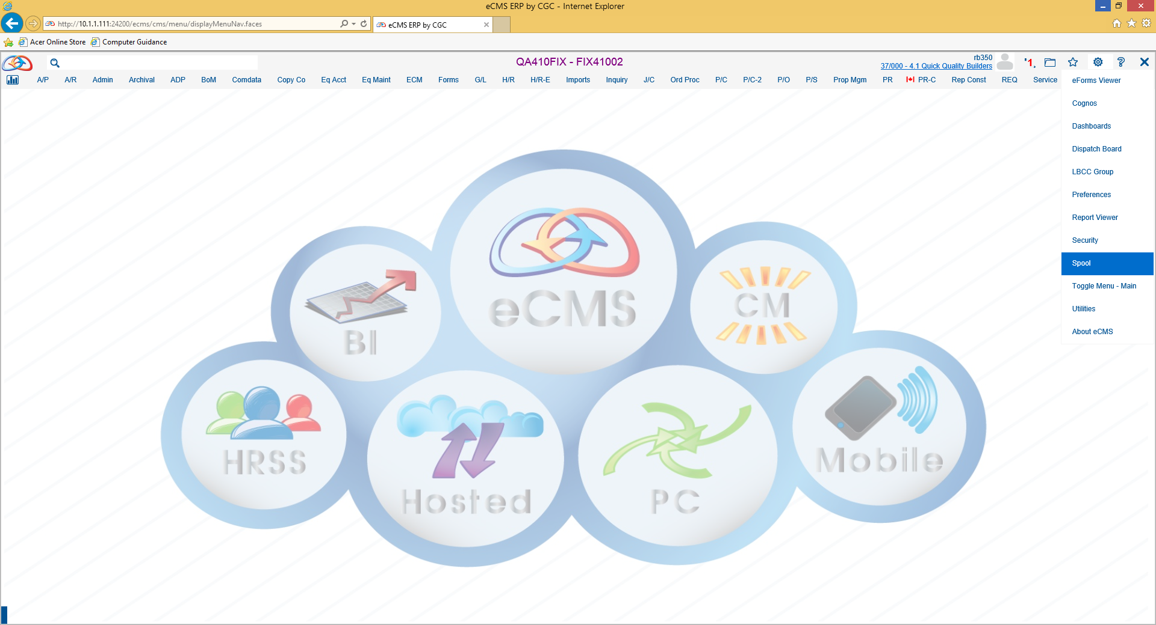
Payroll Timecard Template Import
Check the Spool File

Slide 21
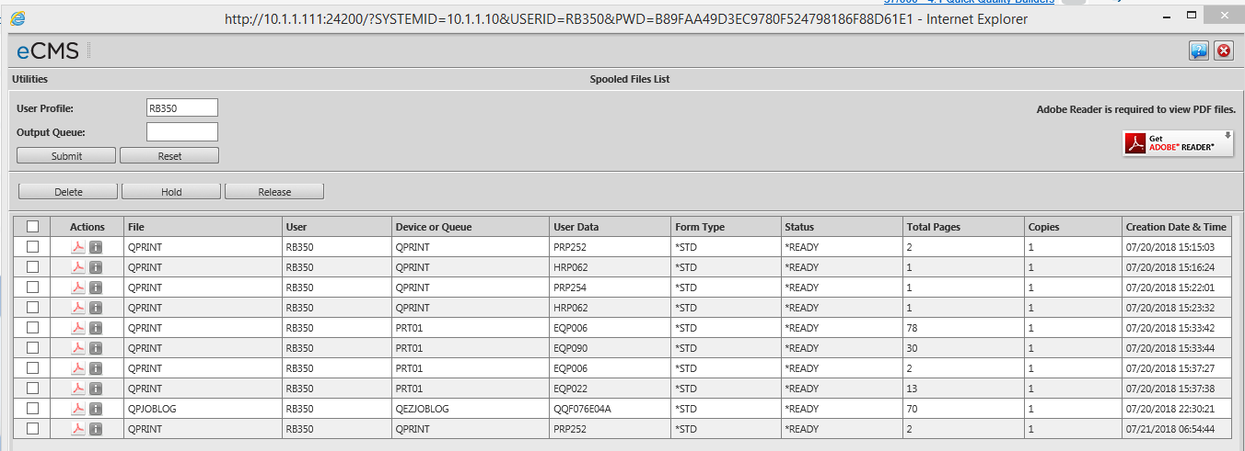
Payroll Timecard Template Import
Double Click on the PDF Icon

Slide 22
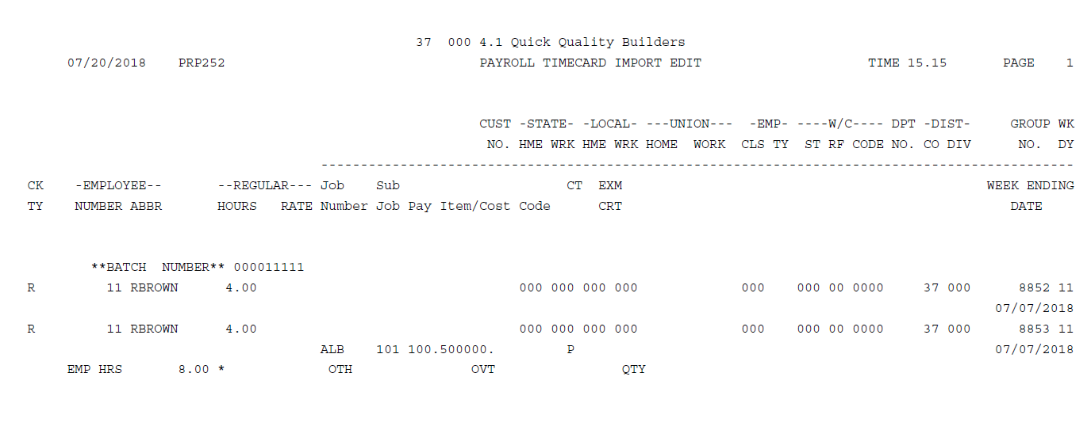
Payroll Timecard Template Import
Payroll Timecard Import Edit Report

Slide 23
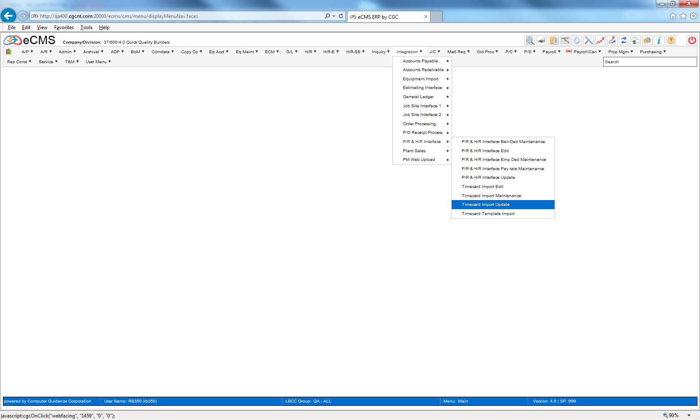
Payroll Timecard Template Import
Integration| PR & HR Interface| Timecard Import Update

Slide 24
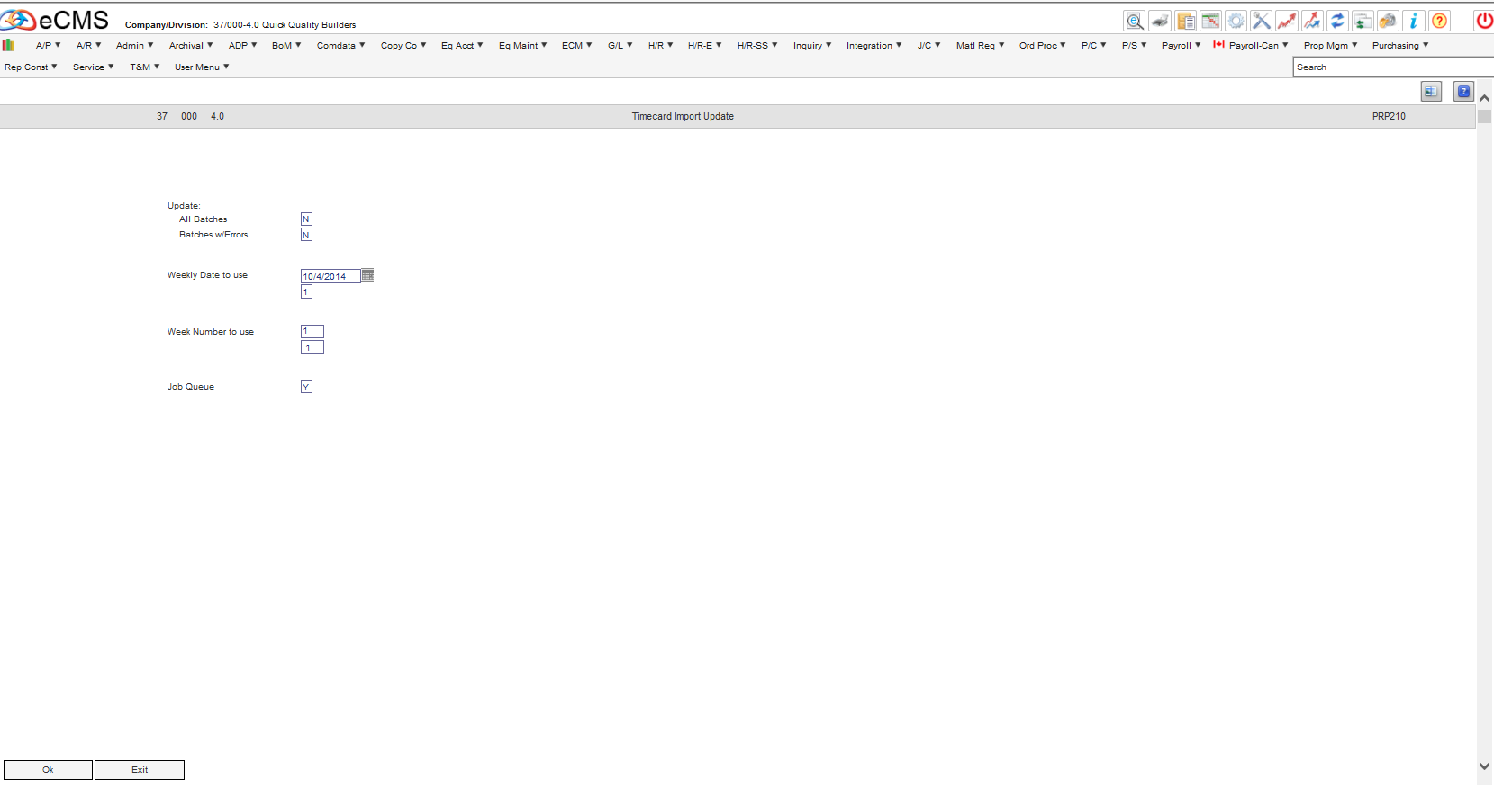
Payroll Timecard Template Update
Enter Criteria

Slide 25
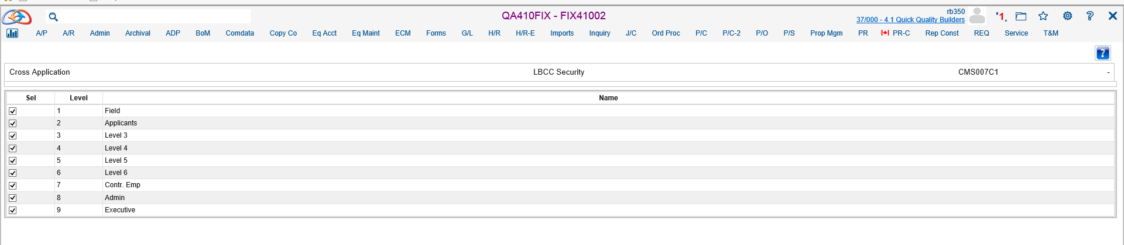
Payroll Timecard Template Update
Select the Level(s) of Security

Slide 26
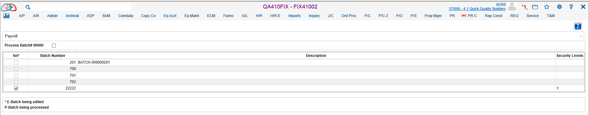
Payroll Timecard Template Import
Select Batch

Slide 27
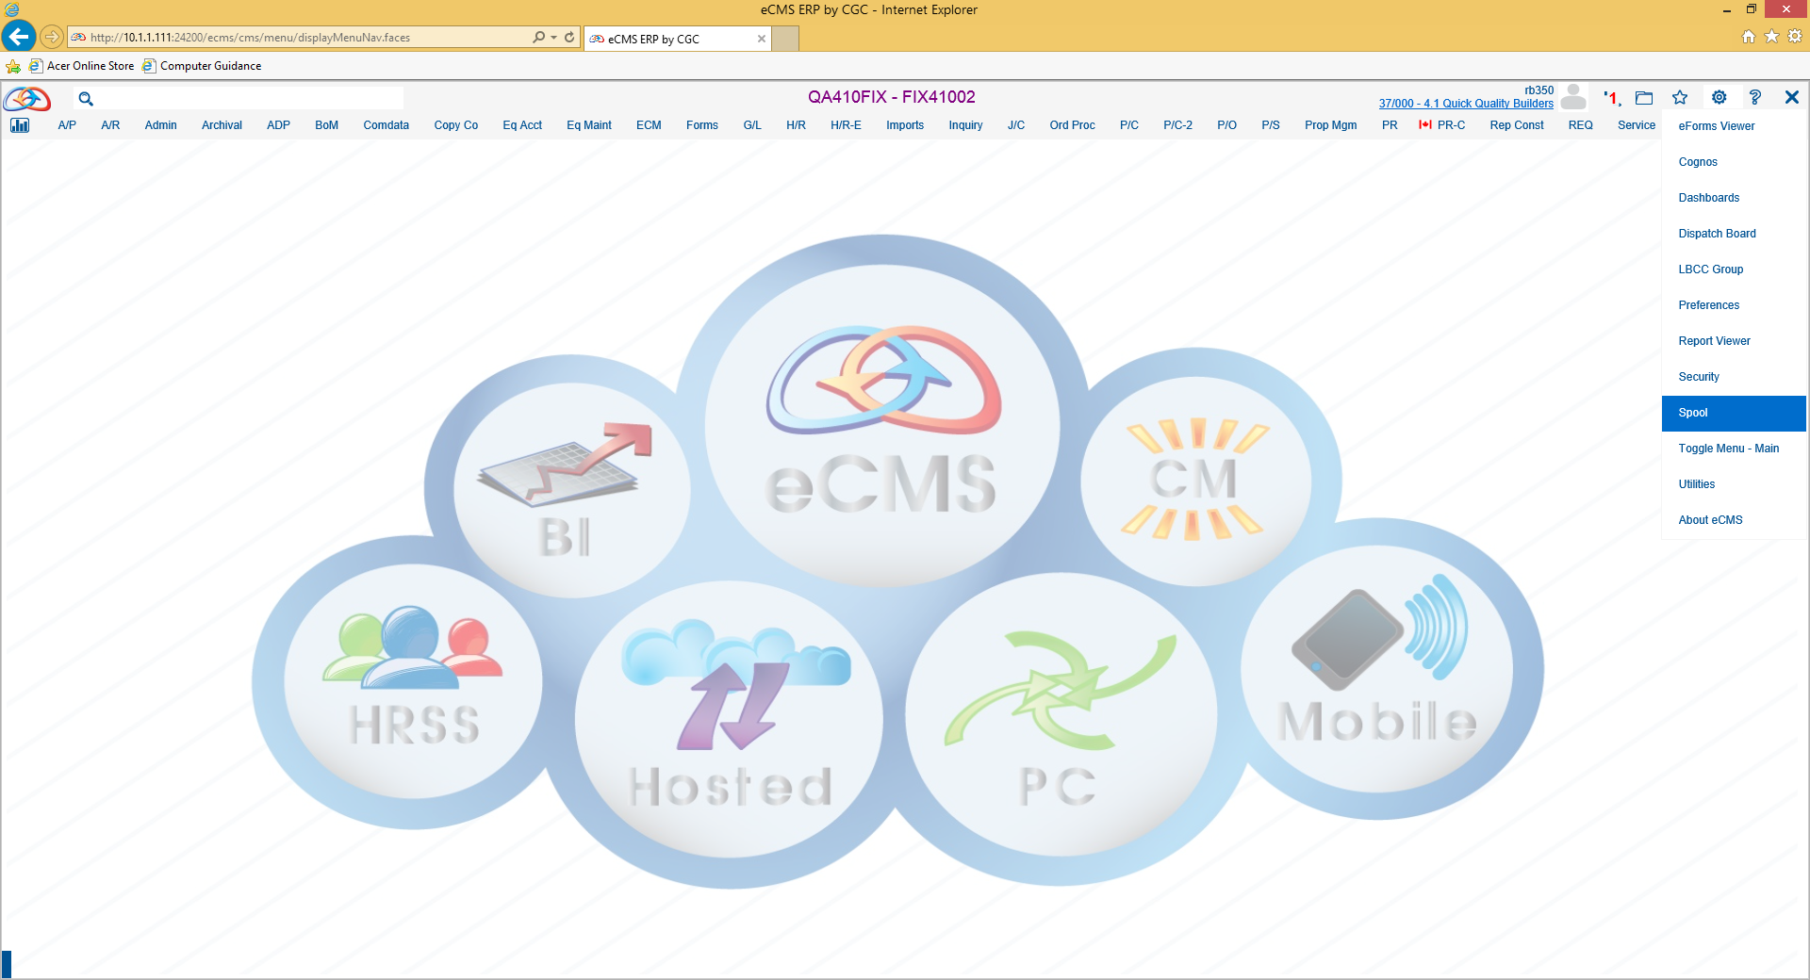
Payroll Timecard Template Import
Check Spool

Slide 28
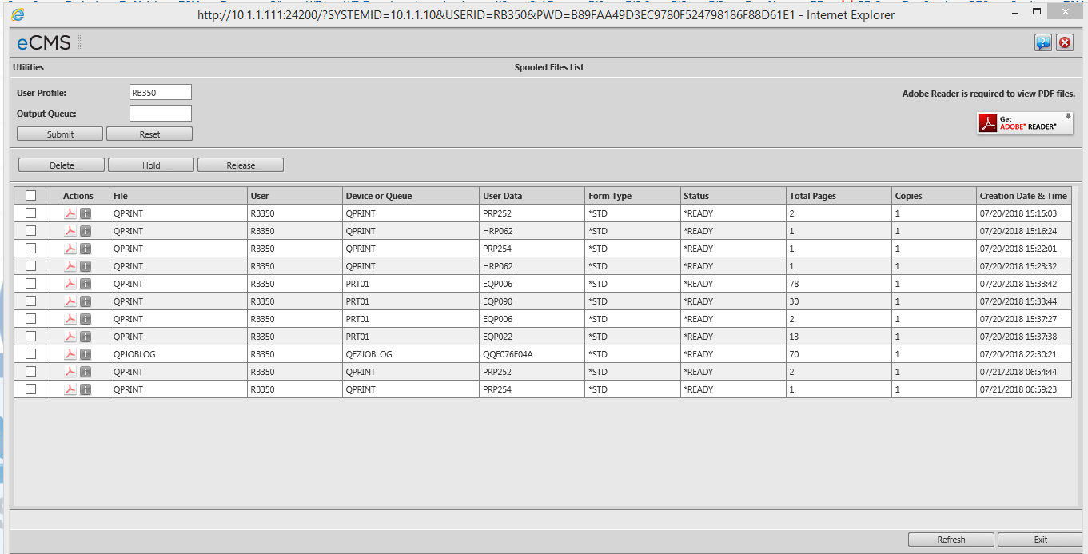
Payroll Timecard Template Import
Double Click on the PDF Icon

Slide 29
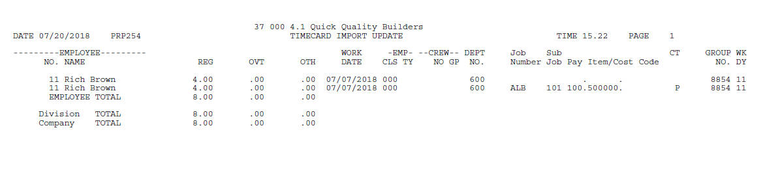
Payroll Timecard Template Import
Timecard Import Update

Slide 30
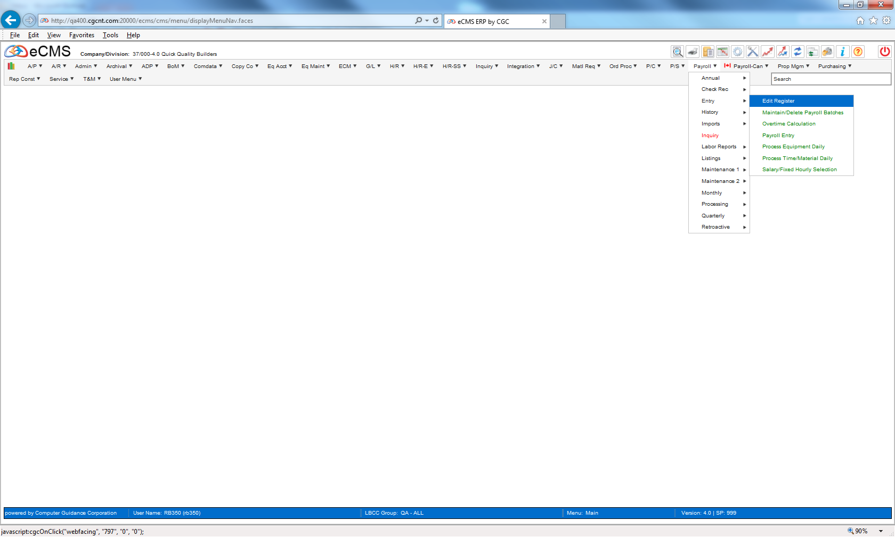
Timecard Payroll Update
Payroll | Entry | Edit Register

Slide 31
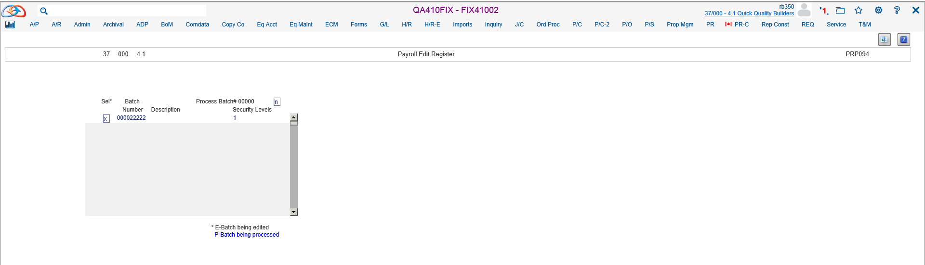
Timecard Payroll Update
Enter Criteria

Slide 32
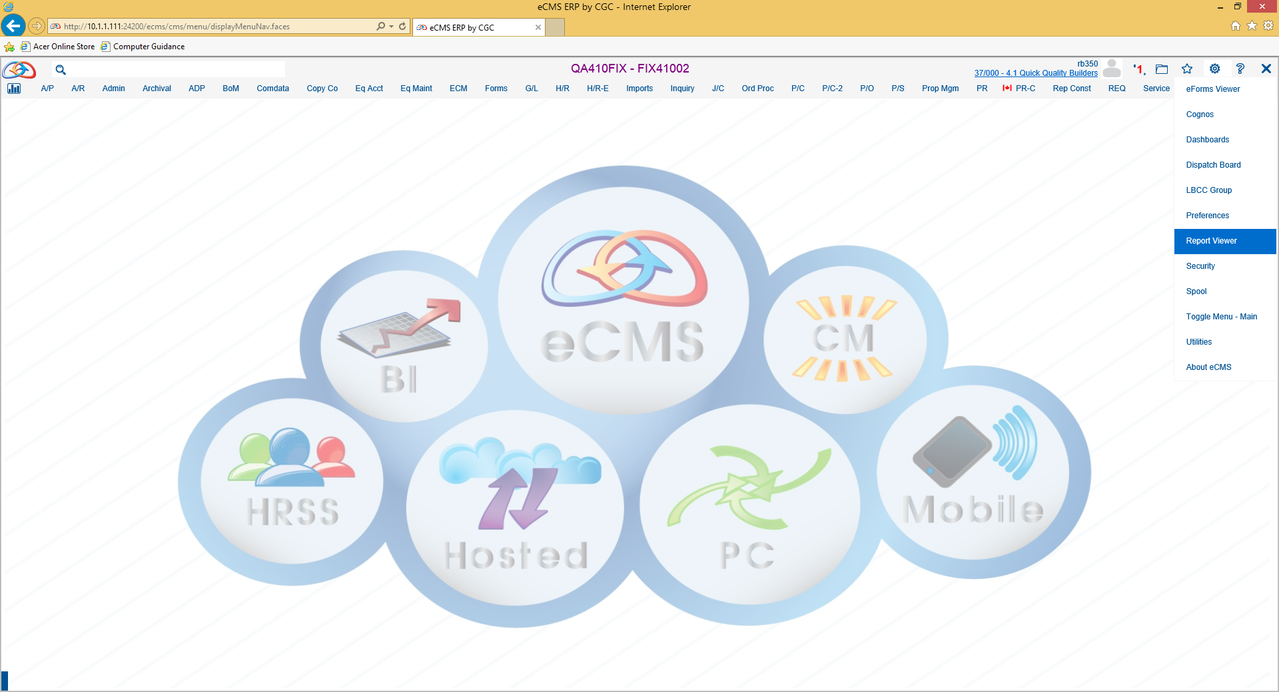
Timecard Payroll Update
Access Report Viewer

Slide 33
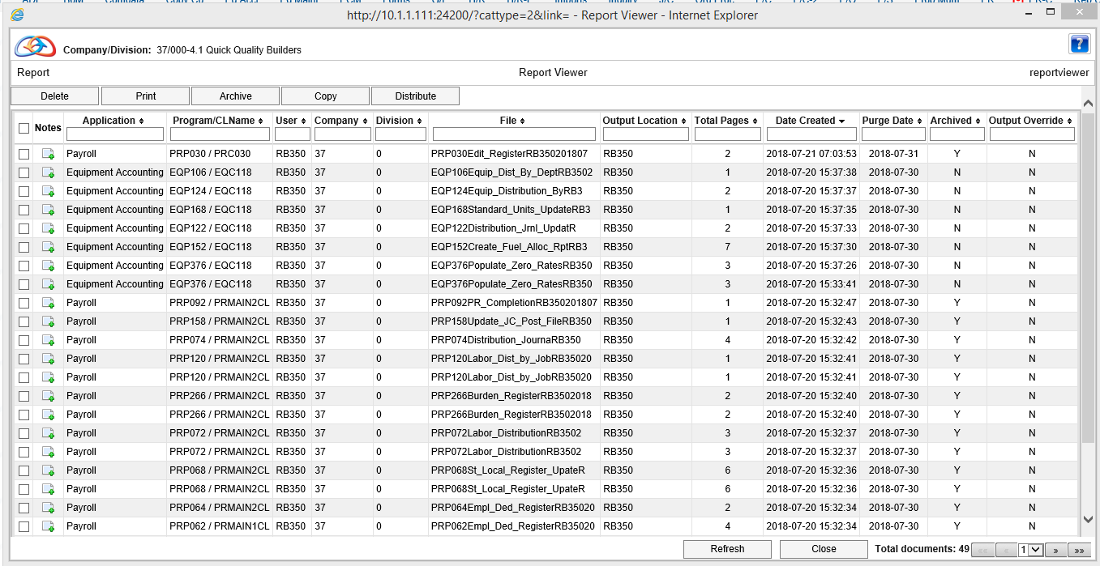
Timecard Payroll Update
Select PDF

Slide 34
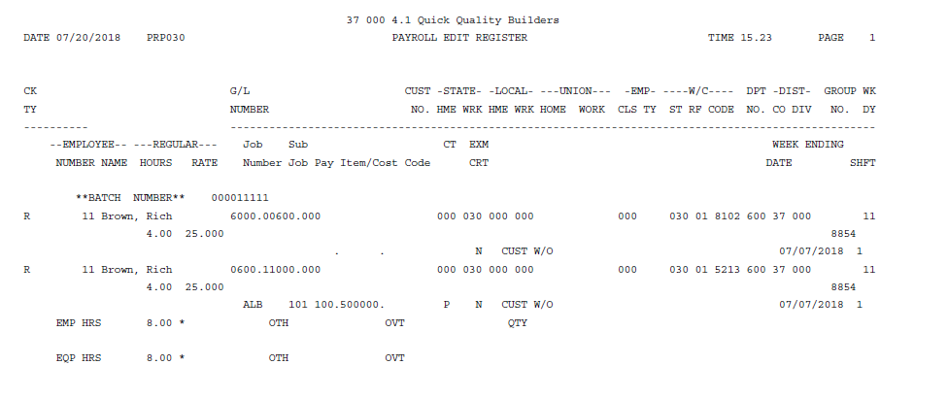
Timecard Payroll Update
Payroll Edit Register

Slide 35
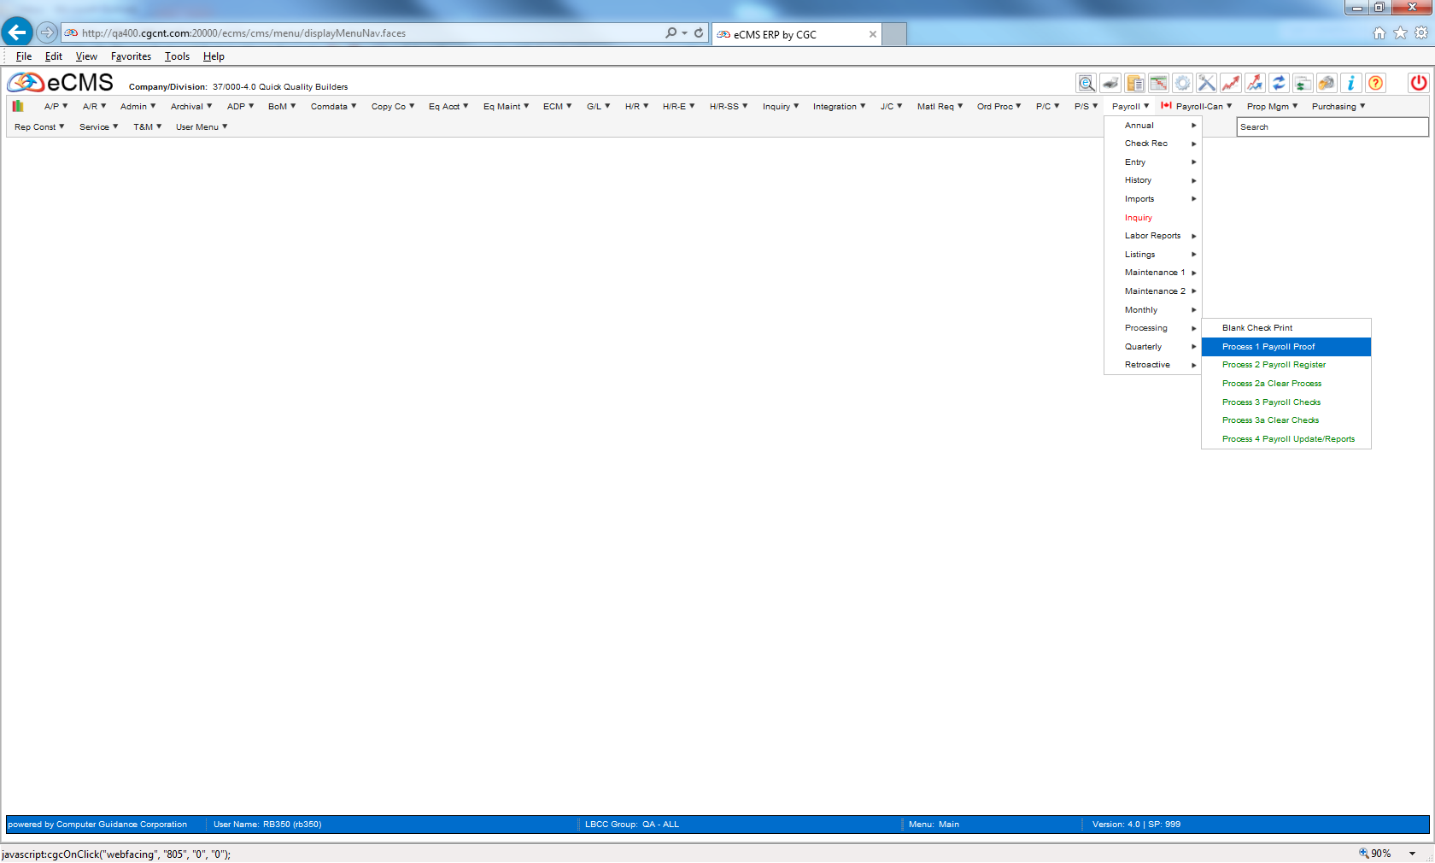
Payroll Processing
Payroll | Entry | Processing | Process 1 – Payroll Proof

Slide 36
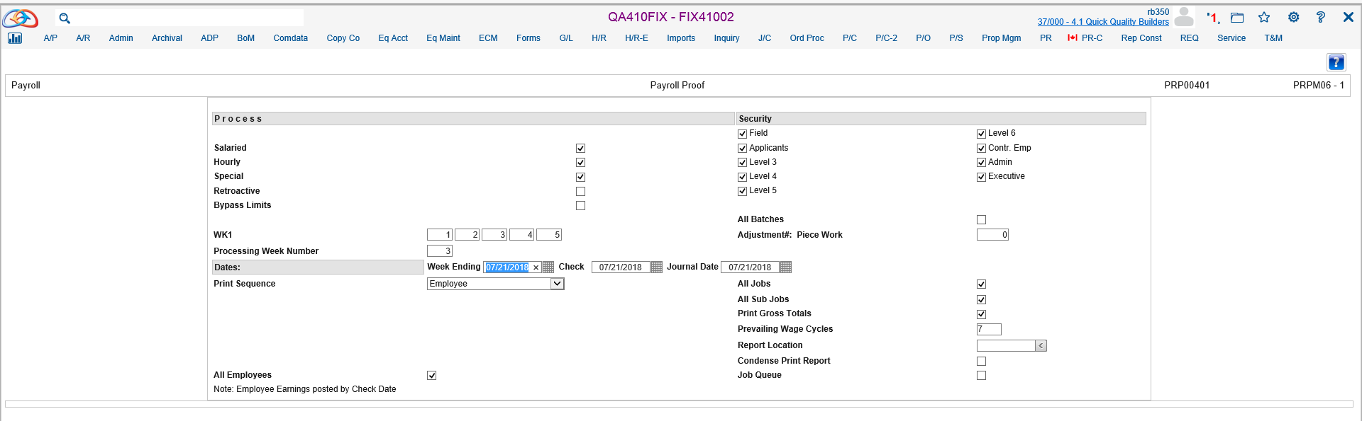
Payroll Processing
Enter Criteria

Slide 37
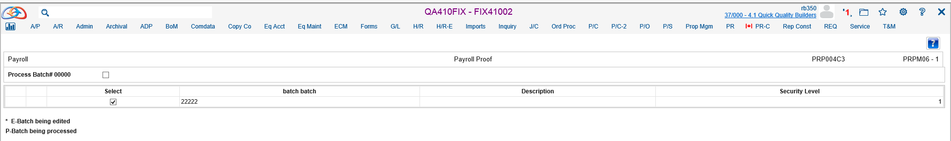
Payroll Processing
Select Batch

Slide 38
Payroll Processing
Access Spool File

Slide 39
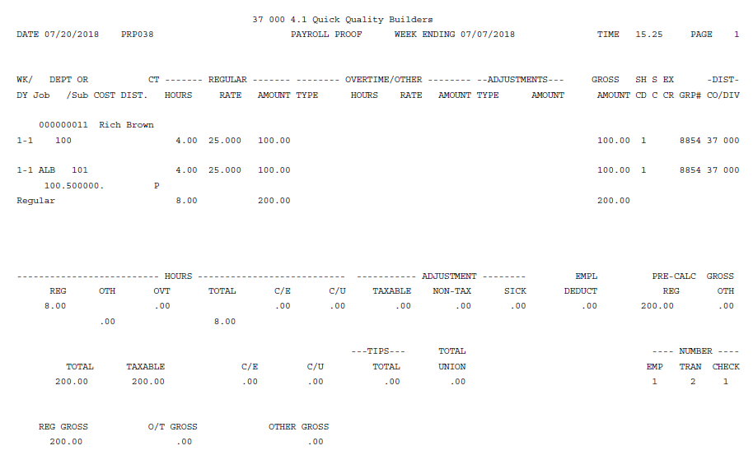
Payroll Processing
Payroll Proof Report

Slide 40
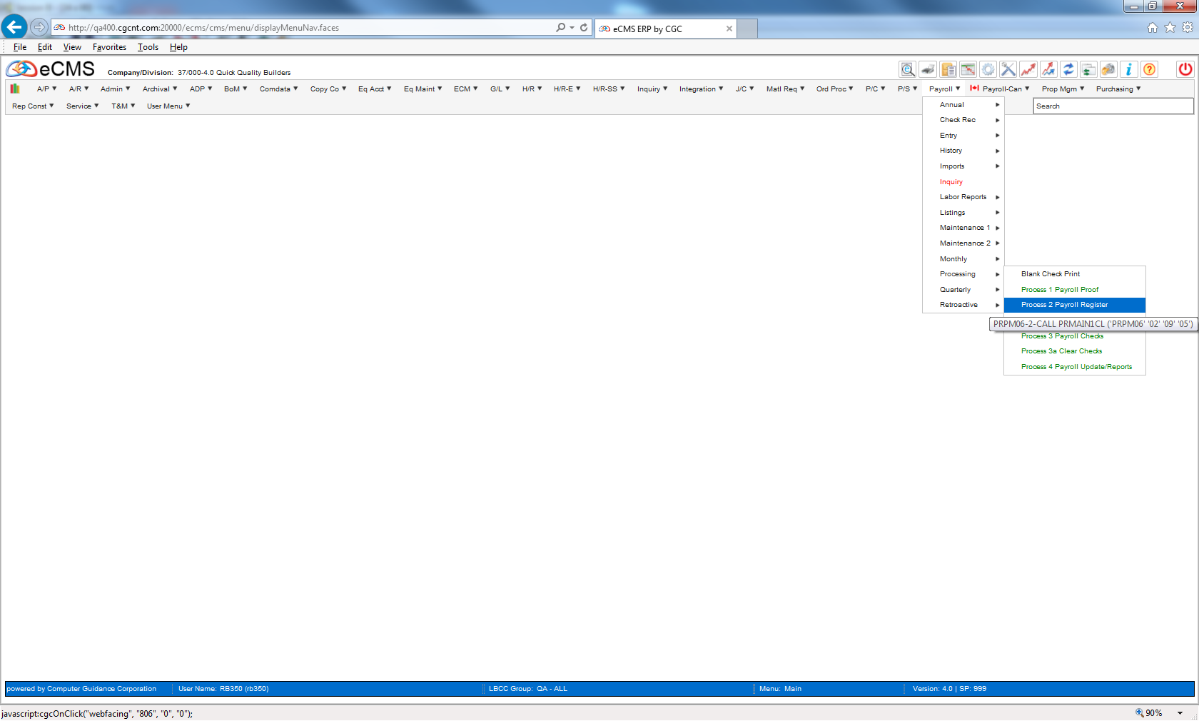
Payroll Processing
Payroll | Processing | Process 2 – Payroll Register

Slide 41
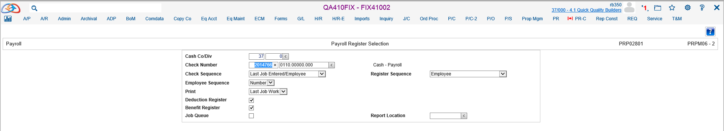
Payroll Processing
Enter Criteria

Slide 42
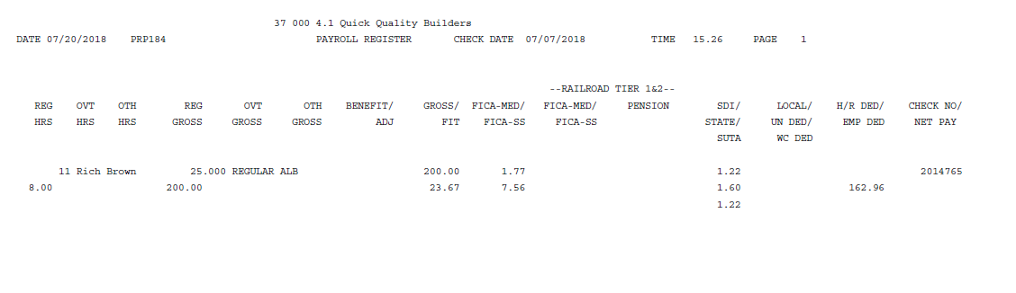
Payroll Processing
Payroll Register

Slide 43
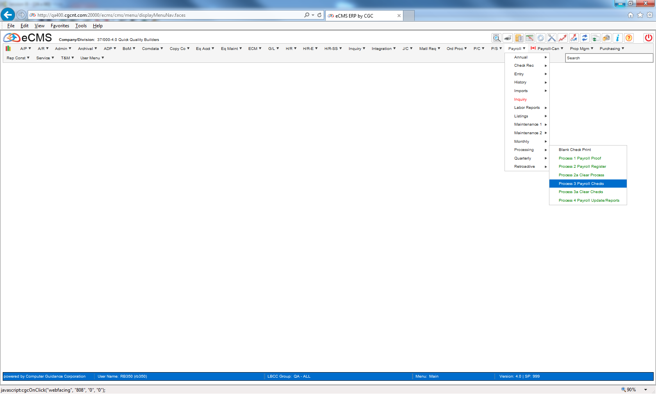
Payroll Processing
Payroll | Processing | Process 3 – Payroll Checks

Slide 44
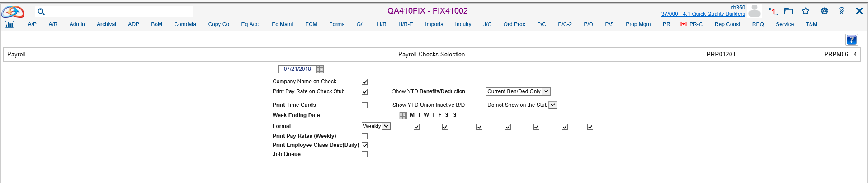
Payroll Processing
Enter Criteria

Slide 45
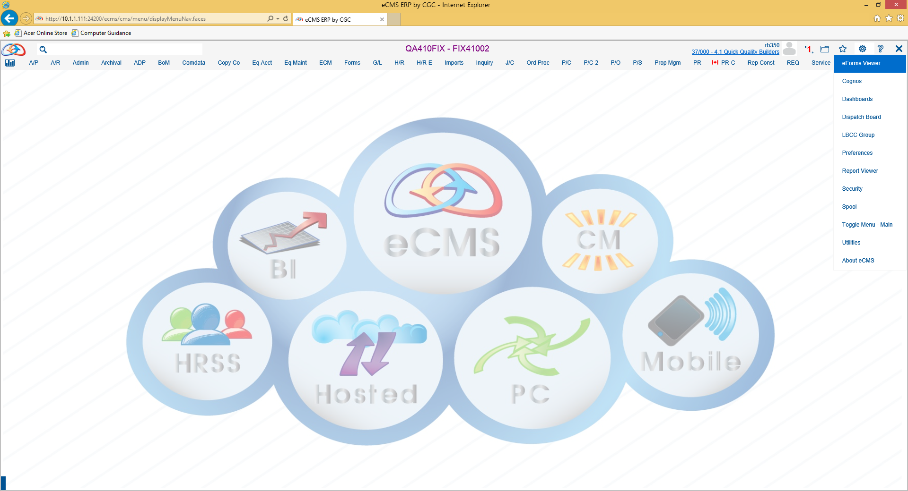
Payroll Processing
Access eForms Viewer

Slide 46
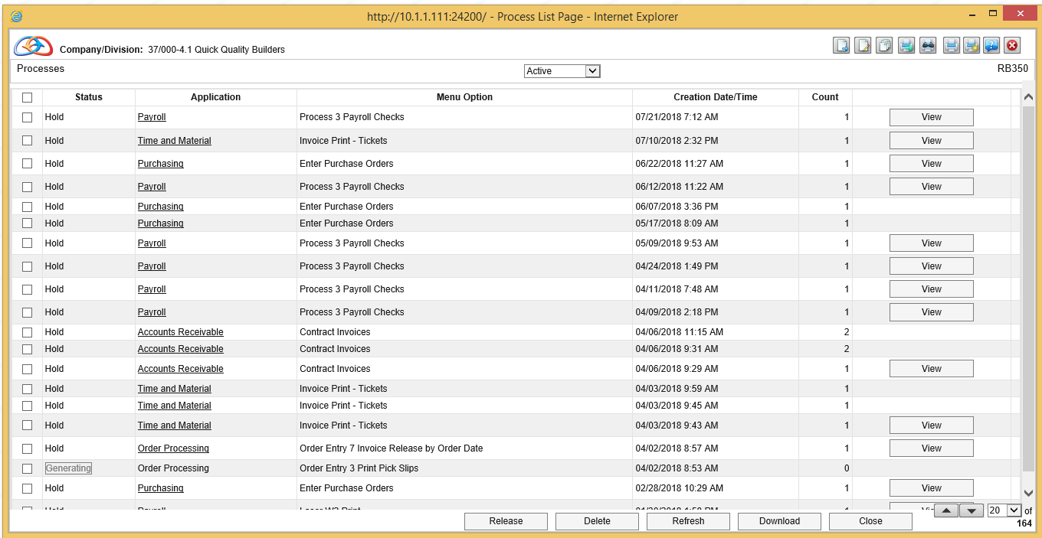
Payroll Processing
Select and Release Check to Print After Review

Slide 47
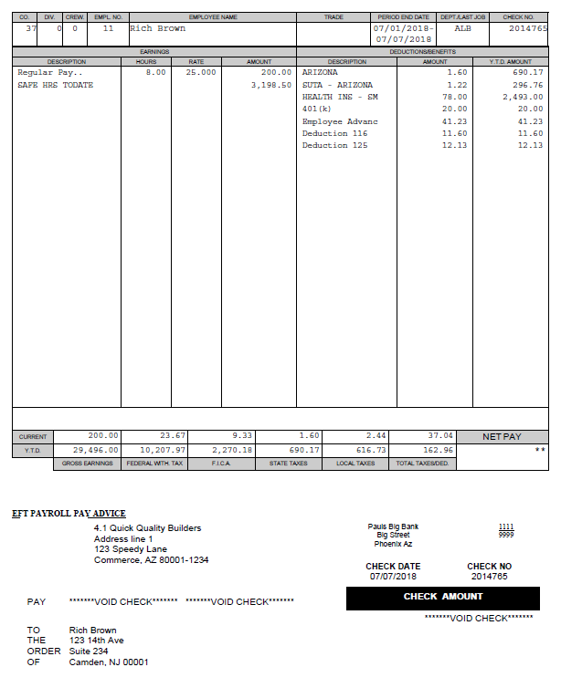
Payroll Processing
Payroll Check

Slide 48
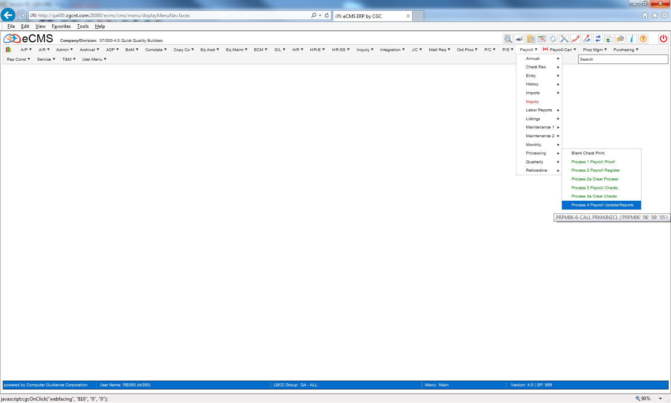
Payroll Processing
Payroll | Processing | Process 4 – Payroll Update/Reports

Slide 49
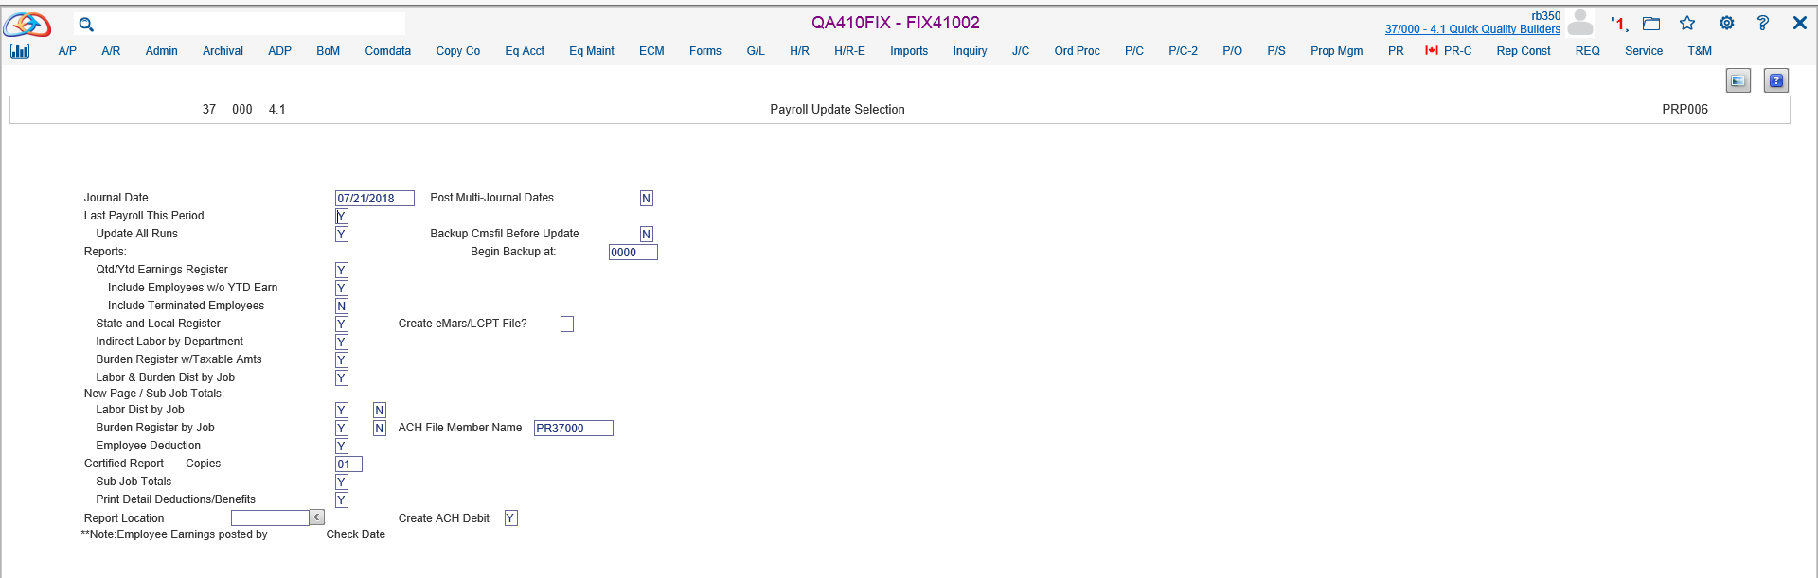
Payroll Processing
Select Criteria

Slide 50
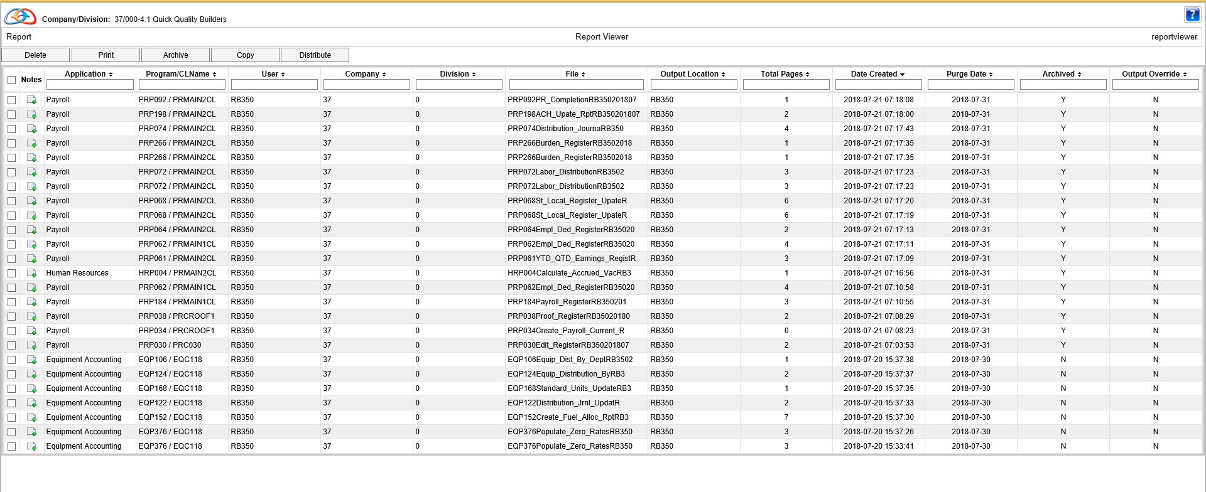
Payroll Processing
Access Spool File and Review Reports Generated

